Slide 1
Pontifical Commission for the Protection of Minors
Marie Collins

Slide 2
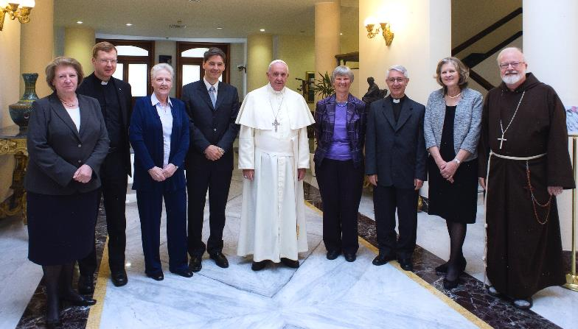
Pontifical Commission for the Protection of Minors
2nd May 2014

Slide 3
Pontifical Commission for the Protection of Minors
Appointed by Pope Francis 22nd March 2014
Commission to act as advisory body to Holy Father
Responsible directly to Pope Francis

Slide 4
Pontifical Commission for the Protection of Minors
Original eight members of the Commission tasked with deciding:
- the structure of the Commission
- position in relation to Vatican departments
- the issues to be addressed
- recommendations as to further members

Slide 5
Pontifical Commission for the Protection of Minors
3 meetings held in 2014
- Working Group structure decided
- independence from dicasteries agreed
- potential new members identified
- survivors meeting Holy Father facilitated
- first proposals approved

Slide 6
Original Members
DR. CATHERINE BONNET - FRANCE CHILD PSYCHIATRIST
psychotherapist, researcher, and author on child sexual abuse and perinatal violence and neglect
MARIE COLLINS - IRELAND
SURVIVOR
founding trustee Marie Collins Foundation
working for those harmed through modern technologies

Slide 7
Original Members
PROFESSOR SHEILA HOLLINS – ENGLAND PSYCHIATRIST
psychotherapist - works with children and adults with intellectual disabilities including those who have been sexually abused
CARDINAL SEAN O’MALLEY OFM Cap. – UNITED STATES
serves as President of the Commission and as Archbishop of Boston, and as a member of the Council of Cardinals which advises His Holiness, Pope Francis

Slide 8
Original Members
REV. DR. HUMBERTO MIGUEL YANEZ, SJ ARGENTINA - MORAL THEOLOGIAN
Director of the Department of Moral Theology at the Pontifical Gregorian University, professor of moral theology at the Gregorian and the Pontifical Urban University
REV. DR. HANS ZOLLNER, SJ – GERMANY - PSYCHOLOGIST
President of the Centre for Child Protection of the Pontifical Gregorian University and Director and Professor of the Institute of Psychology.

Slide 9
Original Members
PROFESSOR SHEILA HOLLINS – ENGLAND
PSYCHIATRIST
psychotherapist who works with children and adults with intellectual disabilities including those who have been sexually abused, and is a life peer in the House of Lords.
CARDINAL SEAN O’MALLEY OFM Cap. UNITED STATES
serves as President of the Commission and as Archbishop of Boston, and as a member of the Council of Cardinals which advises His Holiness, Pope Francis
.

Slide 10
Original Members
DR. CLAUIDO PAPALE – ITALY
CANON LAWYER
civil lawyer, professor of canon law at the Pontifical Urban University, and an official of the Congregation for the Doctrine of the Faith
HON. HANNA SUCHOCKA – POLAND PROFESSOR OF CONSTITUTIONAL LAW
specialist in human rights at the University of Poznan, and was Prime Minister of the Republic of Poland and Ambassador of Poland to the Holy See.

Slide 11
Original Members
REV. DR. HUMBERTO MIGUEL YANEZ, SJ ARGENTINA - MORAL THEOLOGIAN
Director of the Department of Moral Theology at the Pontifical Gregorian University, professor of moral theology at the Gregorian and the Pontifical Urban University
REV. DR. HANS ZOLLNER, SJ – GERMANY - PSYCHOLOGIST
President of the Centre for Child Protection of the Pontifical Gregorian University and Director and Professor of the Institute of Psychology.

Slide 12
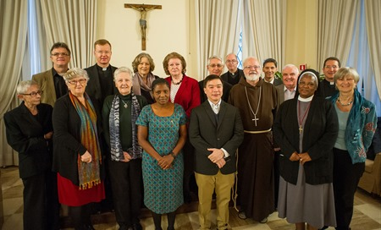
Pontifical Commission for the Protection of Minors
7th February 2015

Slide 13
Latest members
REV. LUIS MANUEL ALI HERRERA - COLUMBIA
Professor of Psychology of Human Development and Social Psychology in the Conciliar Seminary and Professor of Pastoral Psychology at the “Pontificia Universidad Bolivariana”
DR. GABRIEL DY-LIACCO – PHILIPPINES PSYCHOTHERAPIST
pastoral counsellor for various mental health concerns of individuals, couples, families and groups, including victims and perpetrators of abuse

Slide 14
Latest members
BILL KILGALLIN – NEW ZEALAND
Director of the National Office for Professional Standards of the Catholic Church in New Zealand. Prior to that he had a long career in social work and health services in the UK.”
SR. KAYULA GERTRUDE LESA, MSC – ZAMBIA DEVELOPMENT PROFESSIONAL
trainer and author on child protection, human trafficking, refugee rights and the Right to information. Served as a member of the African Forum for Church Social Teaching

Slide 15
Latest members
SR. HERMENEGILD MAKORO, CPS - ZIMBABWE Secretary General of the Southern African Catholic Bishops’ Conference, Higher Diploma in Education from the University of Transkei and a Bachelor of Theology from the University of Natal
KATHLEEN McCORMACK, AM - AUSTRALIA
SOCIAL WORKER
Masters of Management from University of Technology, Sydney – was Director of Welfare of Catholic Care in the Diocese of Wollongong for 29 years

Slide 16
Latest members
MSGR. ROBERT OLIVER – UNITED STATES
serves as the Secretary of the Commission, following many years in child protection work for the Archdiocese of Boston, the U.S. Conference of Catholic Bishops, and Promoter of Justice at the Congregation for the Doctrine of the Faith
PETER SAUNDERS - ENGLAND
SURVIVOR
CEO of The National Association for People Abused in Childhood (NAPAC) set up by him 16 years ago.

Slide 17
Latest members
DR. KRYSTEN WINTER-GREEN
UNITED STATES
degrees in Theology, Human Development, Social Work, Religion and Pastoral Psychology. Her concentration in the areas of child abuse include forensics, assessment and treatment of priest/clergy offenders
……………………………..

Slide 18
Summary of Full Membership
6 lay women
2 religious sisters
4 lay men
4 priests
1 cardinal (member of religious order)

Slide 19

17 members on 5 continents
EUROPE
1F/1M England 1F Poland 1F France
1M Italy 1M Germany 1F Ireland
ASIA
1M Philippines
THE AMERICAS
1F/2M USA
1M Columbia
1M Argentina
OCEANIA
1 F Australia
1M New Zealand
AFRICA
1F Zambia 1F Sth Africa
Notes:
In blue lay person
In black clergy

Slide 20
Skills and experience represented on the Commission
Theology Canon law Psychology
Child psychiatry Vulnerable adults Pastoral Psychology
Constitutional law Survivor advocacy Safeguarding
Formation Civil law Pastoral care
Human rights Perpetrator care Church leadership
Human development Forensic Assessment
Differing Cultural perspectives
Diocesan experience of dealing with abuse crisis

Slide 21
How will Commission carry out its’ work?
WORKING GROUP FOR EACH TASK/ISSUE
Commission member will lead each group
A member will only lead one group but can work in others also
Members will chose the groups to which they can best contribute

Slide 22
How will Commission carry out its’ work?
WORKING GROUPS - Collaborators
Experts with the specific skills/experience relevant to working group will be invited to collaborate
they will not become a member of the Commission
Geographical representation

Slide 23
How will Commission carry out its’ work?
EXAMPLES OF WORKING GROUPS
Guidelines in best practice
Survivor issues/healing
Education of church personnel at all levels
Ecclesial and civil norms governing allegations of abuse

Slide 24
How will Commission carry out its’ work?
EXAMPLES OF WORKING GROUPS
Accountability of people in positions of responsibility within the Church
Formation to the priesthood and religious life
Day of Prayer

Slide 25

Commission
Working Group
Working Group
Working Group
Local Church

Slide 26
Guidelines Working Group
3rd May 2011 Circular letter from CDF
96% Guidelines returned by 2015
Many weak
research the documents already received and identify these weaknesses
Input from National Safeguarding bodies

Slide 27
Guidelines Working Group
Value of local experience
As those working on the ground implementing the current Irish safeguarding policy I hope you also will share your experience with the working group.

Slide 28
Questions and Answers

