Slide 1
Safeguarding Children
Revised Standards
2015

Slide 2
Background
Proposed Changes in Legislation
Developments in Practice
Experience of Safeguarding Reviews
Request for Guidance

Slide 3
Structure of “Safeguarding Children” (Revised)
Overarching Policy
  Creating and Maintaining Safe Environments
  Responding and reporting allegations
  Care of the Complainant
  Care and Management of the Respondent
  Training and Support
  Communicating the Church’s Safeguarding Message
  Implementation and Monitoring

Slide 4
Creating and Maintaining
Safe Environments
Communicating
The Church’s Safeguarding
Message
Procedures for Responding to Child Protection
Allegations, Concerns and Suspicions
Implementing and Monitoring the Standards
Care and Support for the
Complainant
Training and
Support for Keeping
Children Safe
Care and Management
of the
Respondent

Slide 5
Policy
One Church Approach Based on:
Gospel Values
International Treaties and National Legislation
Learning from the Past
Commitments to Safeguarding

Slide 6
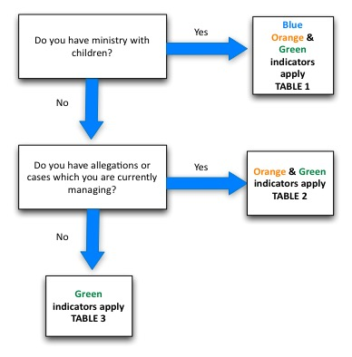
Which Indicators Apply to Your Ministry

Slide 7
1. Creating and Maintaining Safe Environments
All steps taken to create safe environments
Procedures for recruiting personnel
Codes of Behaviour
Guidance on dealing with challenging behaviour from children
Safe Care for children with special needs
Whistle blowing
Complaints procedure
Assessing Risks
Information Technology

Slide 8
2. Procedures for Responding to Child Protection Allegations, Concerns and Suspicions
Personnel are in place to respond
Regular Liaison with Civil authorities
Recording and storage of information
Information sharing in the best interest of children

Slide 9
3. Care and Support for the Complainant
Personnel in place to provide a pastoral and supportive response
Contact with National Agencies, statutory and voluntary
Pastoral response, including Towards Peace

Slide 10
4. Care and Management of the Respondent
Support Personnel in place
Process to inform respondent and if necessary an Interim Management plan
Process after the conclusion of the civil authority investigation leading to a Preliminary Investigation/Collecting the Proofs
Monitoring and supervision

Slide 11
5. Training and Support for Keeping Children Safe
Induction
Training Needs analysis
Basic training programmes in place
Role Specific Training
Children and Guardians provided with information
Supervision and Support

Slide 12
6. Communicating the Church’s Safeguarding Message
Written Communications Plan
Information available and on display
Information for those whose first language is not English; user friendly information.
Links with other to promote safeguarding in the area (regular liaison as per Ferns report)

Slide 13
7. Implementing and Monitoring the Standards
Safeguarding Plan
Annual audits and internal report from the DLP and Safeguarding Committee to the Church Authority
Reviews by NBSCCCI

Slide 14
Consultation and Timeline
Drafts Issued to Bishops, CORI and IMU – March 2015
Responses back through above June 2015
Editing, proofing etc. by September 2015
Induction September 2015 – December 2015
Adoption January 2016

