Slide 1
Exploring a Theology of Safeguarding
National Child Safeguarding Conference
2022

Slide 2
Garrett Sheehan
Opening Address

Slide 3
Cardinal O’Malley
Keynote Speech

Slide 4
Exploring a Theology of Safeguarding
National Child Safeguarding Conference
2022

Slide 5
Sr Colette Stevenson
Welcome Prayer

Slide 6
Ms Teresa Devlin
Welcome and Introduction

Slide 7
The New Apostolic Constitution and the work of Mainstreaming Safeguarding
Rev. Andrew small, OMI
Secretary, pontifical commission for the protection of minors

Slide 8
Agenda
Trajectory of Reform
Abuse as the optic for reform
Praedicate Evangelium
PCPM in Praedicate Evangelium
The “mind” of the legislator: PE explained
Some thoughts on the consequences for safeguarding ministry

Slide 9
Trajectory for Organization Reform:
Pastoral Conversion to Missionary Discipleship
Crisis
Resignation
Response
C9
Reform in pieces (PCPM)
Next
Engage DDF
Draft Statutes
Set up Reporting
Engage Ad Limina Process
Financial Crisis
Praedicate Evangelium
Sexual Abuse
Disaffiliation

Slide 10
Pope Francis to Cardinal Marx
The whole Church is in crisis because of the abuse; furthermore, the Church cannot take a step forward now without accepting this crisis.
It is true that historical events must be evaluated with the hermeneutics of the time in which they happened. But this does not free us from the task of taking responsibility and accepting these events as the history of the “sin that afflicts us”. That is why I believe that every bishop of the Church must accept this and ask himself: What must I do in the face of this catastrophe?
Reform in the Church has been brought about by men and women who were not afraid to expose themselves to crisis and let the Lord reform them.
..to weep, and stammer as best we can: “Depart from me, for I am a sinner”, a legacy left by the first Pope to the popes and bishops of the Church.

Slide 11
Praedicate Evangelium
Missionary Spirit - Evangelization
Service to the Holy Father and the Local Church
Synodality manifests itself in how we operate
decision making and decision taking among dicasteries
mutual listening
Curia and Synod available to HF and the local church
Responsibility for Communio
Healthy decentralization
Promoting effectiveness across units
Enhanced role of Ep Conferences
Appropriate subsidiarity
Participation
Engagement with local church structures
Mark 16:15
Regional solutions expressions of communion
Enhanced Role of Laity in governance, Princ & Crit. 5

Slide 12
Preparatory Document Synod 2023 n. 6
However, we cannot hide from the fact that the Church herself must face the lack of faith and the corruption even within herself. In particular, we cannot forget the suffering experienced by minors and vulnerable people due to sexual abuse, the abuse of power and the abuse of conscience perpetrated by a significant number of clerics and consecrated persons.
For too long the cry of the victims has been a cry that the Church has not been able to hear sufficiently. These are deep wounds that are difficult to heal, for which forgiveness can never be asked for enough and which constitute obstacles, sometimes imposing ones, to advancing in the direction of “journeying together.” The whole Church is called to deal with the weight of a culture imbued with clericalism that she inherits from her history, and with those forms of exercising authority on which the different types of abuse (power, economic, conscience, sexual) are grafted.

Slide 13

PCPM in Praedicate Evangelium

Slide 14
Praedicate Evangelium Art 78
Location
Mission
Governance

Slide 15
Praedicate Evangelium Art. 78
Location
Presso il Dicastero è istituita la Pontificia Commissione per la Tutela dei Minori
Advise Holy Father on best initiatives for safeguarding of minors and vulnerable persons
proporre le più opportune iniziative per la salvaguardia dei minori e delle persone vulnerabili.
Guidelines
assiste i Vescovi diocesani/eparchiali, le Conferenze episcopali e le Strutture gerarchiche orientali, i Superiori degli Istituti di Vita Consacrata e le Società di Vita Apostolica e le loro Conferenze nello sviluppare strategie e procedure opportune, mediante Linee Guida, per proteggere da abusi sessuali i minori e le persone vulnerabili e fornire una
Members and staff
I Membri della Pontificia Commissione sono nominati dal Romano Pontefice per cinque anni e sono scelti tra chierici, membri di Istituti di Vita Consacrata e di Società di Vita Apostolica e laici di varie nazionalità.
Own Statutes and Bye-laws
La Pontificia Commissione ha suoi propri Officiali e opera secondo le proprie norme approvate.

Slide 16
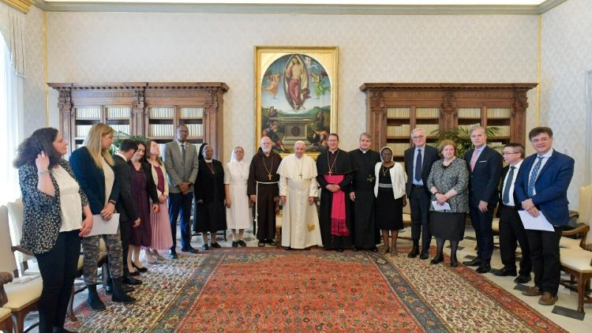
Address to PCPM
April 29, 2022

Slide 17
Location
The Commission for the Protection of Minors is instituted within the Dicastery that deals with sexual abuse on the part of members of the clergy.
The Apostolic Constitution marks a new beginning. It put you in the Curia’s organization chart within that Dicastery, but independent, with a President appointed by the Pope. Independent.
Your close collaboration with the Dicastery for the Doctrine of the Faith and with other Dicasteries ought to enrich your work, while your work can enrich in turn that of the Curia and the local Churches. The determination of the most effective ways for this to happen I leave to the Commission and to the Dicastery, to the Dicasteries.

Slide 18
Mission
It is your responsibility to expand the scope of this mission in such a way that the protection and care of those who have experienced abuse may become normative in every sector of the Church’s life.
Your close collaboration with the Dicastery for the Doctrine of the Faith and with other Dicasteries ought to enrich your work, while your work can enrich in turn that of the Curia and the local Churches. The determination of the most effective ways for this to happen I leave to the Commission and to the Dicastery, to the Dicasteries.
I would like you to propose better methods to enable the Church to protect minors and vulnerable persons and to assist the healing of survivors, in the recognition that justice and prevention are complementary. Indeed, your service provides a proactive and prospective vision of the best practices and procedures that can be implemented in the entire Church.
Working together, these concretely implement the Church’s duty to protect all those for whom she is responsible. That duty is grounded in the conception of the human person in his or her intrinsic dignity, with special concern for the most vulnerable. The efforts made on the level of the universal Church and of the Particular Churches will implement the plan of protection, healing and justice, in accord with their respective competences.

Slide 19

Mission – Vos Estis Article 2
For this reason, I urge you to assist the Conferences of Bishops – this is very important: to assist and oversee in dialogue with the Conferences of Bishops – in establishing suitable centres where individuals who have experienced abuse, and their family members, can find acceptance and an attentive hearing, and be accompanied in a process of healing and justice, as indicated in the Motu Proprio Vos Estis Lux Mundi (cf. Art. 2).
This effort will also be an expression of the Church’s synodal nature, of communion and subsidiarity. Do not forget the meeting we had almost three years ago with the Presidents of the Conferences of Bishops. They are to establish commissions and the means needed to implement processes of care for persons who have been abused, with all the methods that you have, and for punishing abusers. And you must oversee this. I encourage you, please.

Slide 20
Governance
Nonetheless, I have made your leadership and personnel distinct, and you will continue to relate directly with me through your President Delegate. It was placed there, because it was not possible to have a “satellite commission”, circling around but unattached to the organization chart. It is there, but with its own President, appointed by the Pope.
The Apostolic Constitution marks a new beginning. It put you in the Curia’s organization chart within that Dicastery, but independent, with a President appointed by the Pope. Independent.
The determination of the most effective ways for this to happen I leave to the Commission and to the Dicastery, to the Dicasteries.

Slide 21
Annual Report
I would like you, on an annual basis, to prepare for me a report on the Church’s initiatives for the protection of minors and vulnerable adults.
This might be difficult at the beginning, but I ask you to begin where necessary, in order to furnish a reliable account on what is presently being done and what needs to change, so that the competent authorities can act.
This report will be a factor of transparency and accountability and – I hope – will provide a clear audit of our progress in this effort. Without that progress, the faithful will continue to lose trust in their pastors, and preaching and witnessing to the Gospel will become increasingly difficult.

Slide 22



Shifts conversation from cases to policy
Might model local church reporting
Exhibits clear identity and purpose
Public accountability
Manages Change by measuring progress (or regress)
Annual Report: Some potential benefits
Standardizes impact categories
Tool for discernment about Reform
Flexible to adapt to change in Guidelines

Slide 23
What you cannot measure, you cannot change

Slide 24
Some concluding thoughts
PE seeks to stimulate a conversion to a missionary dimension in line with Evangelii Gaudium urging to bring the supernatural gift of faith.
The Curia is in the context of the reform of the whole Church. People working in Curia-like settings are a key elements of the wider reform. If the whole Church is facing this “crisis” how does safeguarding reveal the “splendid grace”
Being close to the DDF incorporates safeguarding into not only the core structure but the core tasks. Safeguarding is essential to the preservation of faith and morals.

Slide 25
Some concluding thoughts
So far the CDF has done its work “in an incomplete way.” The proactive, preventive and protective side represented by the PCPM is lacking.
Do we see the work we do in light of the need to re-propose the faith in these unique times? “to find adequate means to re-propose the perennial truth of the Gospel of Christ.” Jubilee 2025, Pilgrims of Hope?
Might the model of governance lead to more participative governance? How might accountability translate into participation? Certification and good standing of ministers?
Notes:
How does safeguarding work take on a missionary nature?

Slide 26
Theological Perspectives on Safeguarding Children and Adults
Jessie Rogers
St Patrick's Pontifical University, Maynooth

Slide 27
A Theology of Safeguarding
Children
Hospitality
Power

Slide 28
Mark 8:22-10:52 On the way to Jerusalem
Bracketed by miracle stories of blind men being healed.
  "they look like trees walking" Mark 8:24
  "At once he could see again and followed him along the road."
The followers of Jesus 'see', but they have a journey to take before they really understand.

Slide 29
Yeast
“Watch out—beware of the yeast of the Pharisees and the yeast of Herod.” (Mark 8:15)
Yeast of the Pharisees = clericalism, lack of openness to outsiders
Yeast of Herod = power over, violence

Slide 30
Mark 9:33-37
Then they came to Capernaum; and when he was in the house he asked them, “What were you arguing about on the way?” But they were silent, for on the way they had argued with one another who was the greatest.
He sat down, called the twelve, and said to them, “Whoever wants to be first must be last of all and servant of all.” Then he took a little child and put it among them; and taking it in his arms, he said to them, “Whoever welcomes one such child in my name welcomes me, and whoever welcomes me welcomes not me but the one who sent me.”

Slide 31
Mark 9:40-42
Whoever is not against us is for us. For truly I tell you, whoever gives you a cup of water to drink because you bear the name of Christ will by no means lose the reward.
“If any of you put a stumbling block before one of these little ones who believe in me, it would be better for you if a great millstone were hung around your neck and you were thrown into the sea.
".. abuse survivors do not feel loved and accepted by God and by others to the same degree as nonabused subjects, and .. experience substantially greater difficulty in trusting in God's plan and provision for them, as well as in finding meaning and purpose in their lives."
Terese. A. Hall "Spiritual Effects of Childhood Sexual Abuse in Adult Christian Women," Journal of Psychology and Theology 25/2 (1995) 133.

Slide 32
Mark 10:13-16
People were bringing little children to him in order that he might touch them; and the disciples spoke sternly to them. But when Jesus saw this, he was indignant and said to them, “Let the little children come to me; do not stop them; for it is to such as these that the kingdom of God belongs. Truly I tell you, whoever does not receive the kingdom of God as a little child will never enter it.” And he took them up in his arms, laid his hands on them, and blessed them.

Slide 33
Some additional theological perspectives.
Ecclesiology
The Church as sacrament of Christ: a place of welcome, healing, encounter and growth.
Theological anthropology
human beings are called to participate, given dignity and purpose, made for union with God and made for community.

Slide 34
Catholic Social Teaching
Option for the poor and vulnerable
Solidarity
Common good
Community and participation

Slide 35
Concluding observations
If something is safe for the most vulnerable, it is safe for everyone.
The decision to put the child in the centre would be a significant step in a process of conversion to a different way of exercising power in the Church.
Our treatment of children is a true reflection of how we treat Christ.
A theology of safeguarding needs a theology of childhood, a theology of hospitality and a genuinely Christian theology of power.

Slide 36
BREAK

Slide 37
GROUP WORK

Slide 38
LUNCH

Slide 39
Niall Moore
Children’s Rights and Theology,
Barriers and Acceptance in Child Safeguarding

Slide 40
‘Our generation will show that it can rise to the promise found in each young person when we know how to give them space. This means that we have to create the material and spiritual conditions for their full development; to give them a solid basis on which to build their lives; to guarantee their safety and their education to be everything they can be […]’
Pope Francis

Slide 41
What do you Mean by Rights?

Slide 42

Three Important Concepts
Universal
Inalienable
Indivisible and interdependent
Free image from Microsoft Word

Slide 43
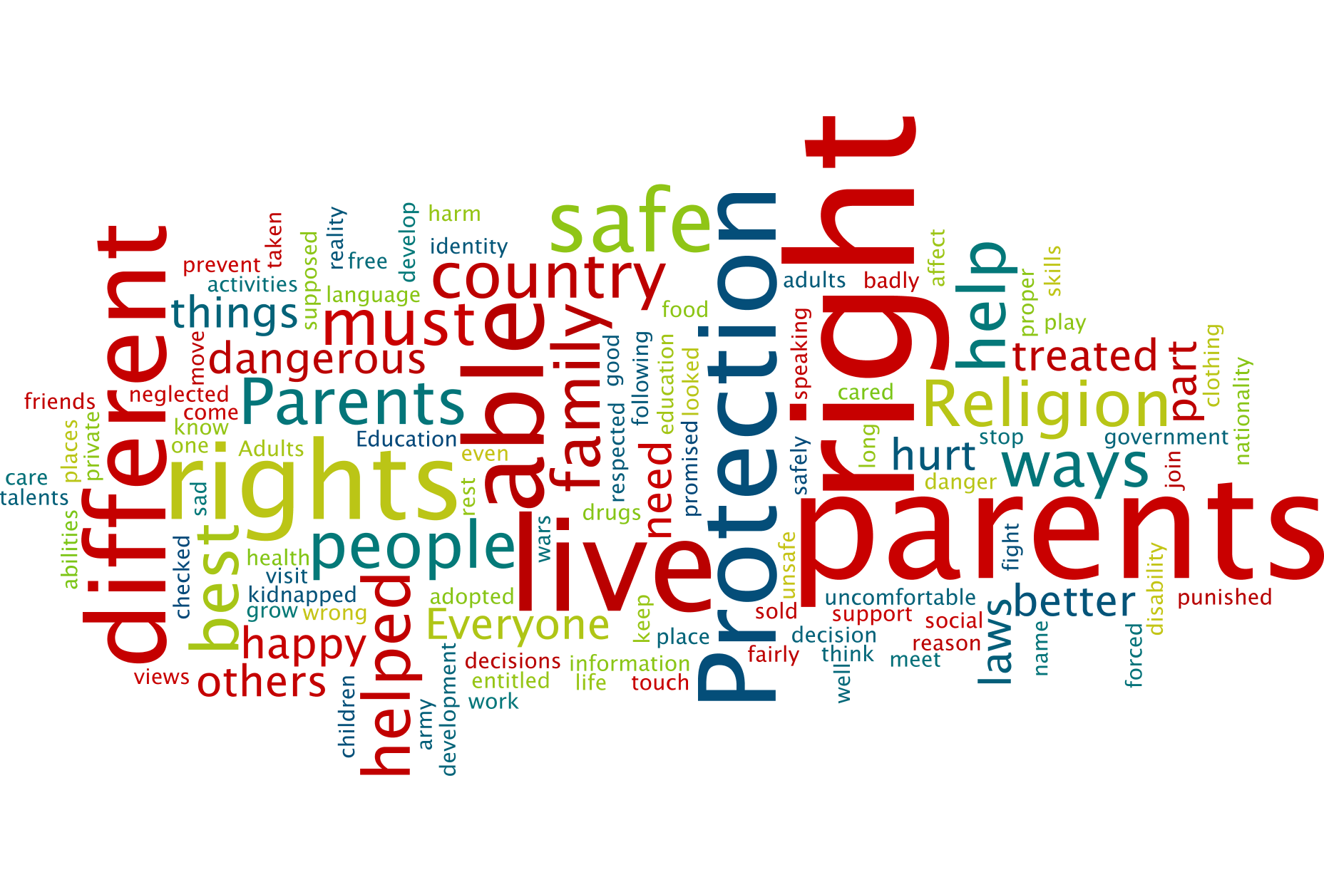

Slide 44

Dual Nature
‘ dual nature of [...] the Government of the Vatican City State and also as a sovereign subject of international law having an original, non-derived legal personality independent of any territorial authority or jurisdiction’.
Free image from pixabay

Slide 45
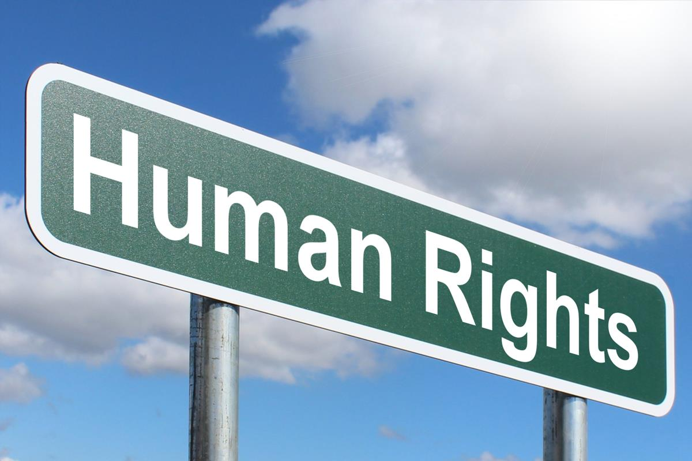
‘...each individual man is truly a person [...] he has rights and duties which together flow as a direct consequence of his nature. These rights and duties are universal and inviolable and there altogether inalienable.’
This Photo by Unknown Author is licensed under CC BY-SA

Slide 46
‘...by acceding to the Convention on the Rights of the Child, the Holy See intends to give renewed expression to its constant concern for the well-being of children and families. In consideration of its singular nature and position the Holy See, in acceding to this Convention, does not intend to prescind in any way from its specific mission which is of a religious and moral character.’

Slide 47
‘ratifies or accedes to an international agreement following international law and practice, it also manifests its moral authority and thereby encourages States to ratify the treaty and to accomplish their respective obligations’

Slide 48
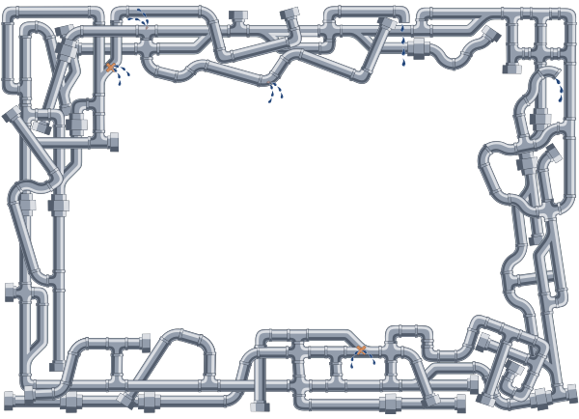
Mental Plumbing
Patterns of thinking and belief ‘tend to be invisible and ignored until something goes obviously wrong, such as leaks or blockages. Then people realise how vitally their lives are affected by hidden pipes (or beliefs) and see that the most practical thing to do is sort out the (mental) plumbing.’

Slide 49
Children as Property

Slide 50
Children as Incapable or Not Yets

Slide 51
Children needing protection

Slide 52
Children being not fit for rights

Slide 53
Children’s rights as an individualistic and anti social concept

Slide 54
Scaffolding by Seamus Heaney
Masons, when they start upon a building,
Are careful to test out the scaffolding;
Make sure that planks won’t slip at busy points,
Secure all ladders, tighten bolted joints.
And yet all this comes down when the job’s done
Showing off walls of sure and solid stone.
So if, my dear, there sometimes seem to be
Old bridges breaking between you and me.
Never fear. We may let the scaffolds fall
Confident that we have built our wall.

Slide 55
Thank You

Slide 56
Mr Paschal Moynihan
Safeguarding Vulnerable People, Human Rights Approach in the Context of Church Ministry

Slide 57
Safeguarding Ireland.
  Established in 2015 as part of the HSE Adult Safeguarding Policy.
  Restructured since – nine member Board of Directors.
  National Safeguarding Advisory Committee.
  Registered with Companies Registration Office and Charities Regulatory Authority.
  Promote safeguarding of vulnerable adults, protect them from abuse by persons, organisations and institutions and develop a national plan for promoting their welfare.

Slide 58
Safeguarding Ireland.
  Strategic Plan 2022-2025.
  Adult Safeguarding Charter.
  www.safeguardingireland.org

Slide 59
Safeguarding Defined.
There are a variety of definitions.
“Safeguarding is putting measures in place to promote people’s human rights and their health and well being and empowering them to protect themselves.” (revised HSE Policy).
“Safeguarding means measures that are put in place to reduce the risk of harm, promote and protect people’s human rights and their health and wellbeing, and empowering people to protect themselves.”
(MHC & HIQA - National Standards for Adult Safeguarding)

Slide 60

Safeguarding.

Slide 61

Safeguarding.

Slide 62
Abuse Defined.
“A single, or repeated act, or omission, which violates a person’s human rights or causes harm or distress to a person.” (HSE).
“…any act, or failure to act, which results in a breach of a vulnerable person’s human rights, civil liberties, physical and mental integrity, dignity or general well being, whether intended or through negligence, including sexual relationships or financial transactions to which the person does not or cannot validly consent, or which are deliberately exploitative. Abuse may take a variety of forms.” (HIQA)

Slide 63
Vulnerability.
Vulnerability can occur as a result of challenges to decision-making capacity, intellectual disability, physical disability, mobility challenges – in effect in any situation where one person is dependent on another or others.
Vulnerability is dictated by circumstances – it is not a diagnosis, e.g, coercive control.
‘Vulnerability to abuse is influenced by both context and individual circumstances’ (HSE).
Vulnerability may be transient.

Slide 64
Types of Abuse.
Physical.
Financial.
Sexual.
Emotional.
Coercive Control.
Discrimination.
Neglect.
Self Neglect

Slide 65
Human Rights.
‘Human rights are rights inherent to all human beings, regardless of race, sex, nationality, ethnicity, language, religion, or any other status. Human rights include the right to life and liberty, freedom from slavery and torture, freedom of opinion and expression, the right to work and education, and many more. Everyone is entitled to these rights, without discrimination’.
(United Nations)

Slide 66
Human Rights.
Constitution of Ireland - “All citizens shall, as human persons, be held equal before the law”. (40.1).
International Obligations
  The European Convention on Human Rights 1950 – rights respected by the State (Article 1), to freedom from torture, inhuman and degrading treatment (Article 3), to liberty and security of person (Article 5), to respect for private and family life (Article 8), to freedom from discrimination (Article 14) and to freedom from abuse of their rights (Article 17).
  Hague Convention on the International Protection of Adults 2000 provides for the protection in international situations of adults who, by reason of an impairment or insufficiency of their personal faculties, are not in a position to protect their interests.

Slide 67
Human Rights.
UN Convention on the Rights of Persons with Disabilities 2006 –
Respect for inherent dignity, individual autonomy including the freedom to make one’s own choices, and independence of persons;
Non-discrimination;
Full and effective participation and inclusion in society;
Respect for difference and acceptance of persons with disabilities as part of human diversity and humanity;
Equality of opportunity;
Accessibility;
Equality between men and women;
Respect for the evolving capacities of children with disabilities and respect for the right of children with disabilities to preserve their identities.
  Council of Europe Recommendation on Principles concerning Powers of Attorney and Advance Directives for Incapacity September CMR/2009
  Council of Europe Recommendation on the Promotion of Human Rights of Older Persons CMR/2014(2)

Slide 68
Human Rights.
  Council of Europe Recommendation on the Promotion of Human Rights of Older Persons CMR/2014(2)
  Non-Discrimination.
  Autonomy and Participation.
  Protection from Violence and Abuse.

Slide 69
Laws.
Criminal Justice (Withholding of Information on Offences against Children and Vulnerable Persons) Act, 2012.
  Offence to withhold information from An Garda about certain offences against ‘vulnerable persons’. Offences include assault sexual assault, rape, incest and trafficking.
  A ‘vulnerable person’ is defined as an adult:
  a) who - (i) is suffering from a disorder of the mind, whether as a result of mental illness or dementia or (ii) has an intellectual disability, which is of such a nature or degree as to severely restrict the capacity of the person to guard him or herself against serious exploitation or abuse, whether physical or sexual, by another person, or
  b) who is suffering from an enduring physical impairment or injury which is of such a nature or degree as to severely restrict the capacity of the person to guard himself or herself against serious exploitation or abuse, whether physical or sexual, by another person or to report such exploitation or abuse to the Garda Siochana or both.

Slide 70
Church Ministry.
Church has a long tradition of caring for vulnerable – healthcare, hospice care, care of the sick, meals, etc.
Individuals often turn to the church when they are at their most vulnerable and if they are able to do so.
Priests and religous are often in a unique position to observe or be confided in.

Slide 71
Church Ministry.
Christ showed preferential care for the sick, marginalised and vulnerable.
Was a champion for justice.
Christ showed greatest love for those who suffered – parable of Good Samaritan.
‘Truly, I say to you, as you did it to one of the least of these my brothers, you did it to me’. (Matthew)

Slide 72
Church Ministry.
CONSENT.
Presumption. Every effort to gain a person’s consent and understand their wishes/choices.
Assisted Decision Making (Capacity) Act 2015) – Time and issue specific.
  Plan for future – EPA.
Appointment by person when Capacity is in question/shortly in question -
  Decision-Making Assistant: Decision-Making Assistance Agreement.
  Co-Decision-Maker: Co-Decision-Making Agreement.
Appointment by Court when person lacks capacity – when EPA or AHD does not include decision to be made.
  Decision-Making Representative: Decision-Making Representation Order.

Slide 73
Church Ministry.
INTEGRITY.
Genuine respect for dignity and individuality.
Consent and respect for choice.
Collaboration and teamwork.
Supervision.
Professionalism.
Reflection and self awareness.

Slide 74
Church Ministry.
RISK.
Recognition, awareness and assessment of risk - mitigate.
Staff/volunteers – recruitment, supervision, training, support.
Understanding of roles.
Location/environment.
Whistleblowing policy.
Complaints investigation.

Slide 75
Church Ministry.
Should be aware of signs of abuse, regardless of abuse type.
Should listen and support anyone who raises a concern.
Promote trust and maintain integrity, and ethical and professional boundaries.
Arrange home visits in advance and be clear on the nature and reasons for the visit.
Not be paralysed by other’s perceptions or preferences – focus on the individual’s needs and rights.
Maintain the person’s rights as the basis for all interaction.
Be aware that the abuser may not recognise his/her actions as abuse

Slide 76

Abuse.

Slide 77
Church Ministry.
Pastoral care - provision of emotional and spiritual support and is closely linked with safeguarding.
Consider principles underpinning safeguarding
  Respect for and promotion of human rights.
  Presumption of capacity.
  Empowerment and independence.
  Confidentiality.
  Choice.
  Individuality

Slide 78
Church Ministry.
Confidentiality is not absolute. If someone tells you something in confidence but the matter is very serious, every effort should be made to get agreement from the person to agree to seek advice or support.
Matters that pose an immediate or significant risk to a person’s health, safety or security must be reported to An Garda.
Very often relatives are the perpetrators of abuse. This can lead to ambivalence and uncertainty in if or how an abused person wishes to seek support or cope, e.g., financial abuse in older people.
Safeguarding often requires a multi-agency approach and the sharing of concerns. Support, listening, trust, integrity are important elements.

Slide 79

Safeguarding.

Slide 80
Adult Safeguarding Policy.
Definition of safeguarding.
Explanation of different types of abuse.
Promotion and protection of people human rights.
Should be explicit about values and principles.
Risk Assessment.

Slide 81
Adult Safeguarding Policy.
Training.
Safeguarding Expertise.
Collaboration.
Recruitment policies.
Reporting Procedures.

Slide 82
Adult Safeguarding Policy.
Supervision.
Accurate record keeping.
Complaints Policy.
Audit.
Open and Transparent.

Slide 83
Adult Safeguarding Policy.
FREDA Principles –
Fairness.
Respect.
Equality.
Dignity.
Autonomy.

Slide 84
How can Abuse be Prevented.
Respect for Human Rights.
Integrity.
Respect for Confidentiality.
Respect for Autonomy and Empowerment.
FREDA.
Advocacy.
Collaboration.
Risk awareness.

Slide 85
THANK YOU.

Slide 86
GROUP WORK

Slide 87
BREAK

Slide 88
FEEDBACK TO THE PANEL

Slide 89
Mr Garrett Sheehan
Summary from Feedback and Close

