Slide 1
Training for Advisors
18th January 2017

Slide 2
Welcome, Introductions and Prayer

Slide 3
Aims for the Day
To identify and discuss your understanding of the role and what motivates and challenges you.
To identify what we expect the Advisor to do
To give you practical experience and advice on how to carry out the role

Slide 4
Your Role

Slide 5
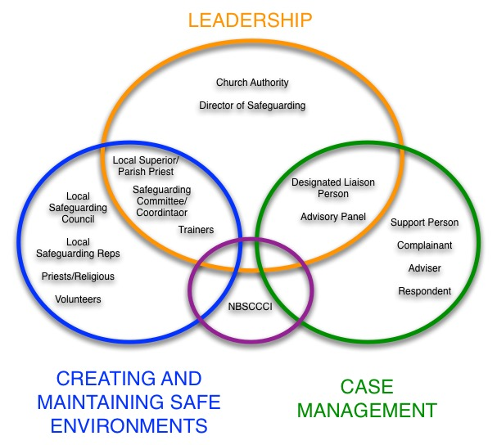

Slide 6
Your Role
Your role is:
Keeping the respondent informed of the process of the case.
Helping direct the respondent to counselling and support.
Recording any meetings or contact they have with the respondent, and reporting to DLP as appropriate.
Upholding the 7 standards in practice and behaviour.

Slide 7
The 7 Standards

Slide 8
Overarching Policy for the Catholic Church in Ireland
As a constituent member of the Catholic Church in Ireland we recognise and uphold the dignity and rights of all children and are committed to ensuring their safety and wellbeing, and will work in partnership with parents/guardians to do this. We recognise each child as a gift from God, and we value and encourage the participation of children in all activities that enhance their spiritual, physical, emotional, intellectual and social development.
All Church personnel (including clergy, religious, staff and volunteers) have a responsibility to safeguard children through promoting their welfare, health and development in a safe and caring environment which supports their best interests and prevents abuse.

Slide 9
What is expected: The Seven Standards
Creating and Maintaining Safe Environments
Procedures for Responding to Child Protection Allegations, Concerns and Suspicions
Care and Support for the Complainant
Care and Management of the Respondent
Training and Support for Keeping Children Safe
Communicating the Church’s Safeguarding Message
Quality Assuring Compliance with the Standards

Slide 10
Questions for Reflection
Where is your copy of the safeguarding policy and associated procedures stored?
Would you know where to get the information you need in an emergency?

Slide 11
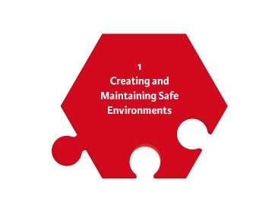
Standard 1
Creating and Maintaining Safe Environments
Church bodies provide an environment for children that is welcoming, nuturing and safe. This may include:
Safe recruitment and vetting practices.
Appropriate Codes of Behaviour for adults/children.
Safe environments and activities for all children.
Safe use of Church property by external groups.
Whistleblowing and complaints
Hazard assessment
Safe use of IT

Slide 12
Questions for Reflection
Do you have safeguarding practices in place where children are involved?
Who checks that these safeguards are in place?

Slide 13
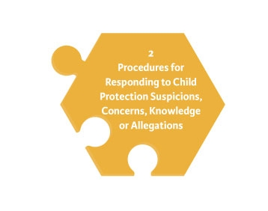
Standard 2
Procedures for Responding to Child Protection Suspicions, concerns, knowledge or allegations.
Clear guidance to ensure a prompt response to allegations, suspicions, and concerns about a child’s safety or welfare.
All concerns are reported promptly to the statutory authorities.
Guiding principle: Safety of the child is the paramount consideration.

Slide 15
Questions for Reflection
Did you know the process of responding to disclosures?
How is this process communicated in your setting?

Slide 16


Standard 3 and 4
Care of Complainant
Care and Management of the Respondent
Complainant Support
Support Person
Towards Healing Counselling
TUSLA Counselling
Pastoral Support
Respondent Support
Supervision
Advisor
Counselling

Slide 17
Questions for Reflection
What contact details do you need in your role?

Slide 18
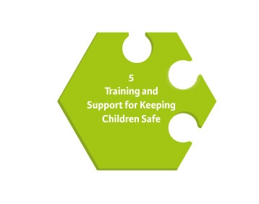
Standard 5
Training and Support for Keeping Children Safe
Relevant training is available for all involved in any way with children to develop and maintain the necessary attitudes, skills and knowledge to keep children safe.
To carry out this role confidently and effectively, they need to be aware of child protection issues.
Everyone has a role to play in child protection and safeguarding.

Slide 19
Questions for Reflection
Do you think you need to be trained?
What kind of training do you need?
How can you access training to fulfil gaps in your knowledge?
Do you feel supported in your role- who can you go to for support?

Slide 20
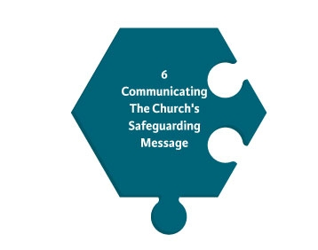
Standard 6
Communicating the Church’s Safeguarding Message
Importance of publicising Church’s safeguarding policy
and procedures.

Slide 21
Questions for Reflection
How do you communicate the message of safeguarding in your work?
How does your Church body engage with children about safeguarding?

Slide 22
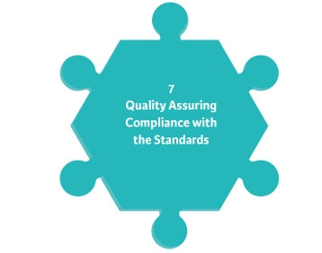
Standard 7
Quality Assuring Compliance with the Standards
Each Church body develops a plan of action to monitor the effectiveness of the steps it is taking to keep children safe.

Slide 23
Questions for Reflection
How are the standards monitored?
Whose responsibility is it to monitor?
How is it done?
How is it resourced?

Slide 24
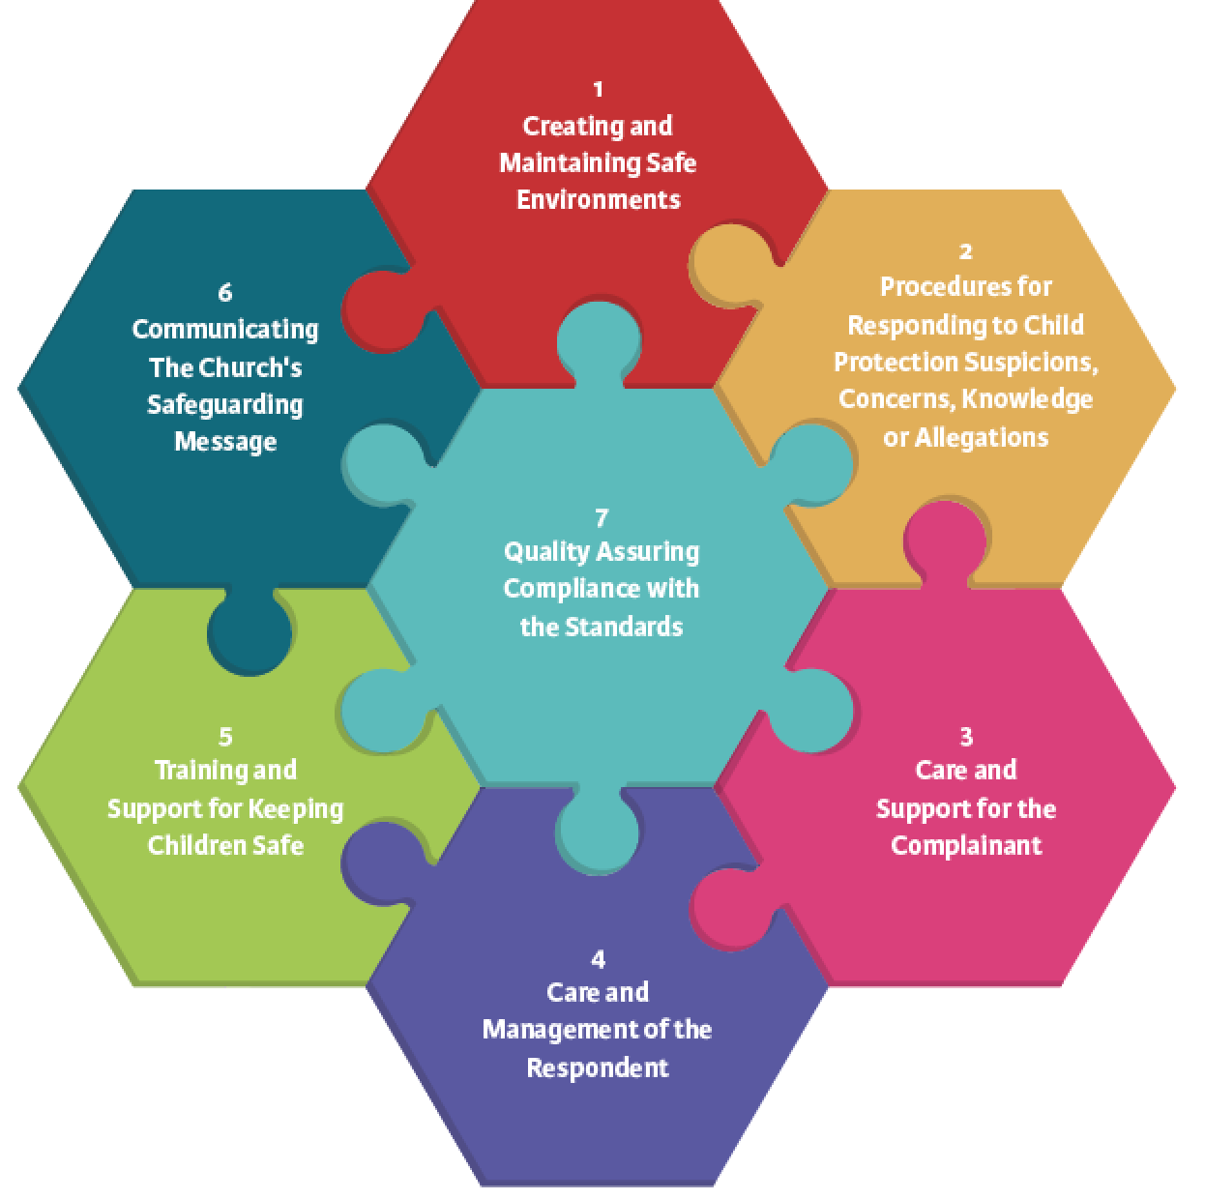

Slide 25
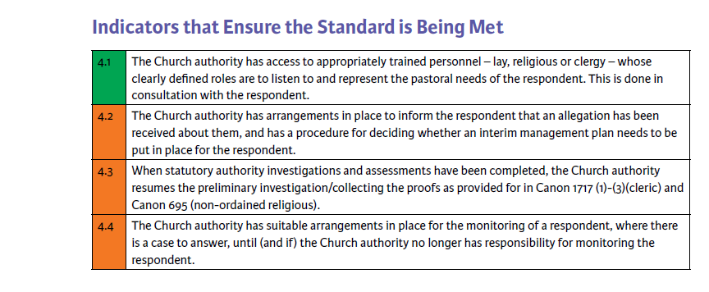

Slide 26
BREAK

Slide 27
Boundaries and Support

Slide 28
Your Role
Your role isn’t:
To be a counsellor
To be a spiritual director
To be the case manager

Slide 29
Your Role
Knowing the role- where do you see the potential for boundaries to be blurred?
How could you prevent this?

Slide 30
Keeping the Respondent Informed

Slide 31
Keeping the Respondent Informed
It is part of your role to keep the respondent
up to date with the process of their case and provide
them with appropriate support or counseling.
To do this you need to understand the process of
case management which you can attend training on.
But you should also be kept informed of the case by
the DLP through supervision.

Slide 32
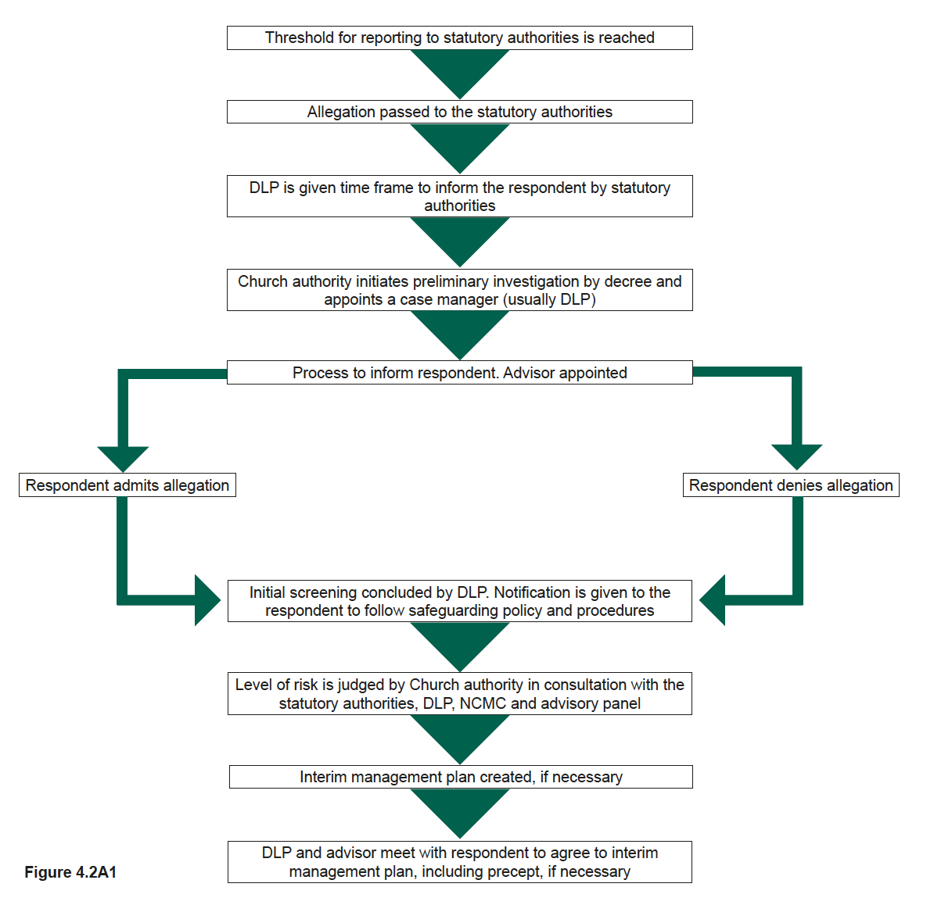
Step 1: This is the same for both religious and clerics

Slide 33
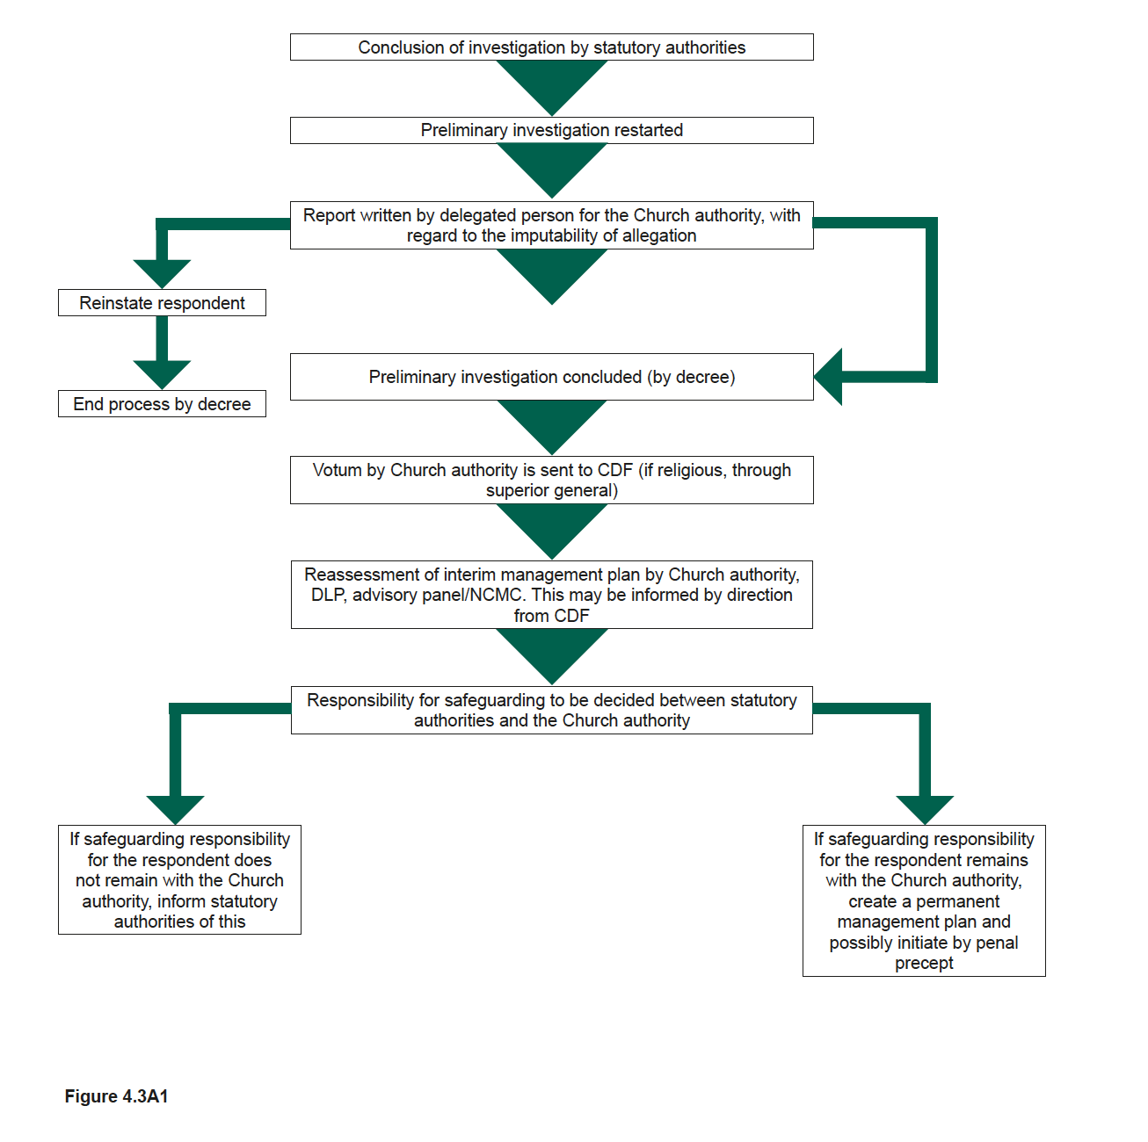
Step 2: For clerics

Slide 34
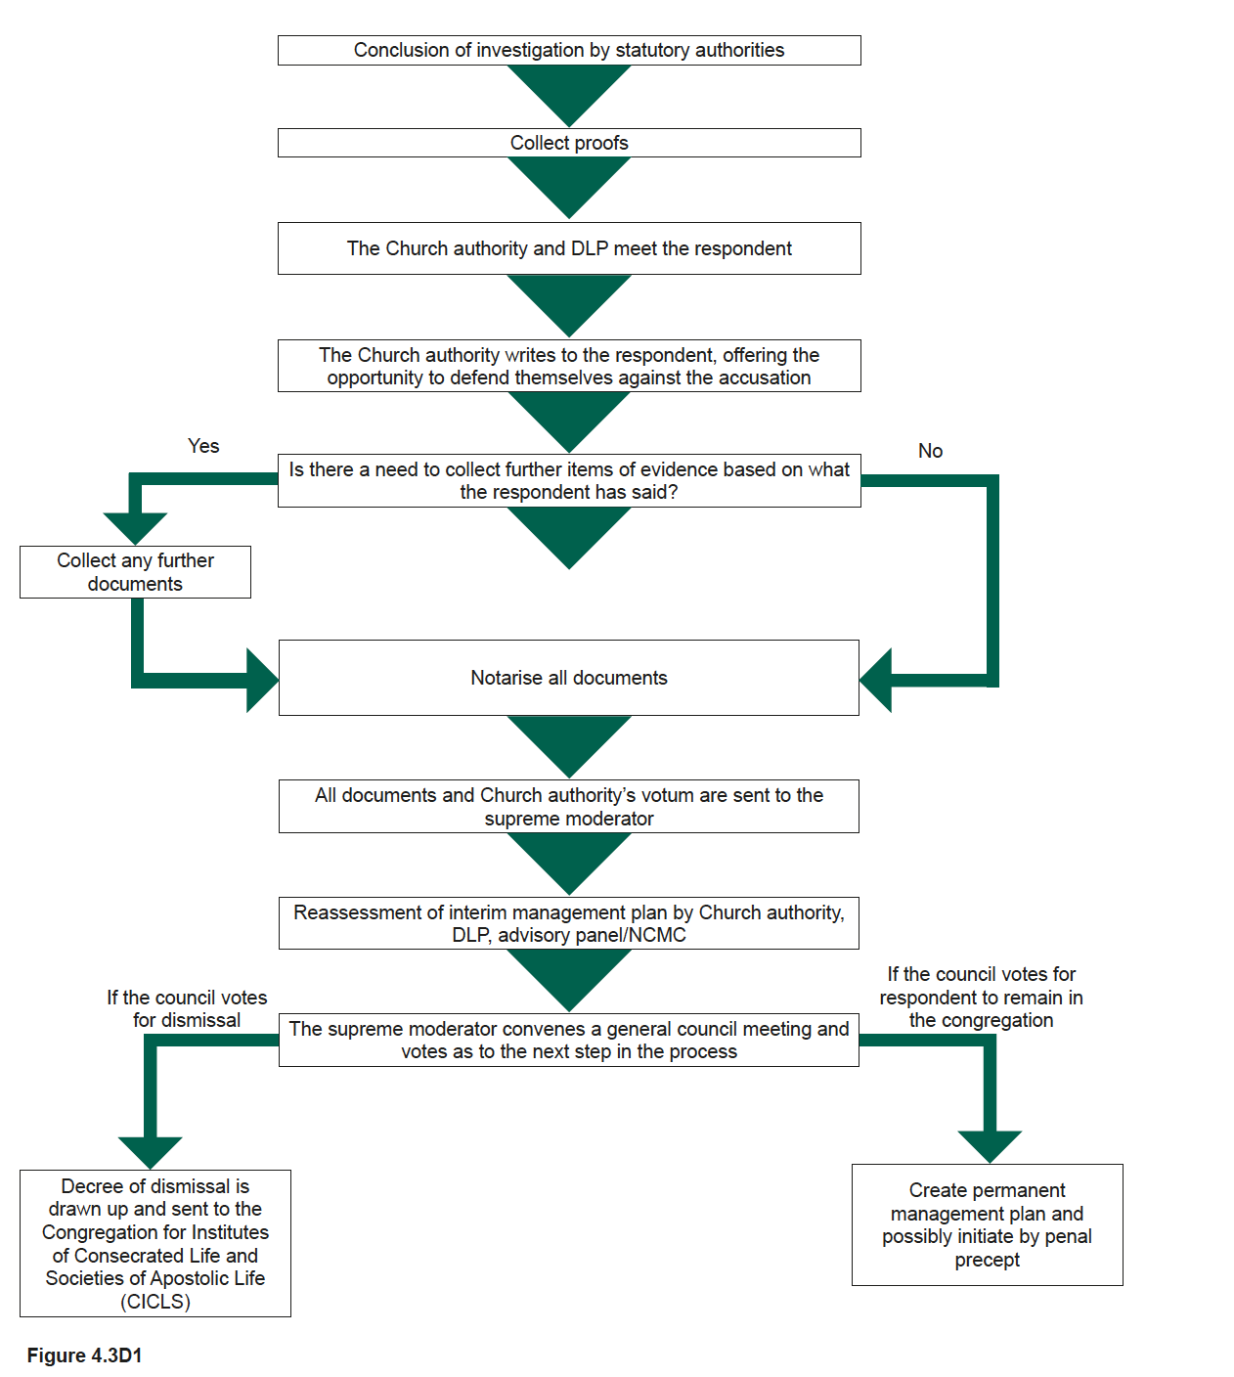
Step 2 (alternative): For non ordained religious

Slide 35
Keeping the Respondent Informed
During your meetings with respondent they may
require support:
If it’s about counselling discuss with the DLP
If it’s about practical things discuss with the DLP
Its important you document and record these
requests and pass to the DLP to put in the case file
Refer to Handout

Slide 36
LUNCH

Slide 37
Recording Contact

Slide 38
Scenarios

Slide 39
What to Record
During your meetings with the respondent a number of
Issues may come up, you should record:
Dates times and locations of meetings
Any requests for support
Any relevant child safeguarding issues that have arisen
If the respondent has knowledge of a crime
If the respondent is suffering from a mental health condition or is suicidal
These should be passed to the DLP who will store them appropriately
Refer to Handout

Slide 40
Issues that you are receiving

Slide 41
What are the main issues that you are receiving from people out of ministry?
How could the NBSCCCI help to address these issues?

Slide 42
Questions and Evaluation

