Slide 1
Compassionate Response Training
14th November 2018

Slide 2
Welcome and Introductions
Teresa

Slide 3
Why we are here and What we have done
Teresa

Slide 4
Aims of Day
To discuss learning from the past
To outline good practice in caring for complainants

Slide 5
Standard 3
Complainants who have suffered abuse as children receive a compassionate response when they disclose their abuse, They and their families are offered support, advice and pastoral care

Slide 6
Learning from the Past
Allegations not believed
Allegation process poorly managed
Legally heavy processes
Process further traumatised complainants

Slide 7
Experience has taught us……
Be available
Act with compassionate
Be open minded
Believe
Accept the discomfort
Give some power to the complainant
Recognise their needs may be life long

Slide 8
Message from Pope Francis
The pain of the victims and their families is also our pain, and so it is urgent that we once more reaffirm our commitment to ensure the protection of minors and of vulnerable adults.”

Slide 9

Towards Peace
Compassionate Response
A Theological Perspective
By Una aLLEN

Slide 10

Gerard W Hughes SJ

Slide 11
Spiritual Trauma
“To lose you is to lose everything,
to be separated from everyone
and everything I have ever loved
and cherished.”

Slide 12
Compassionate Response to Abuse:
Personal Issue
and
Church Issue

Slide 13
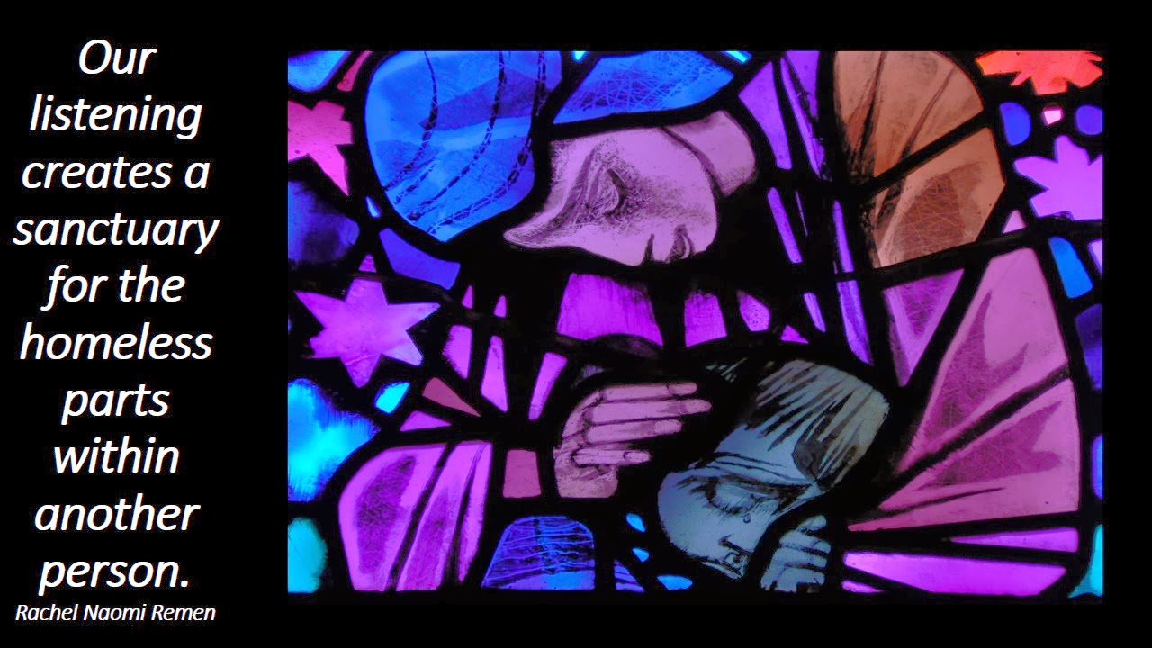

Slide 14

Listening
Being heard is essential to a compassionate response

Slide 15
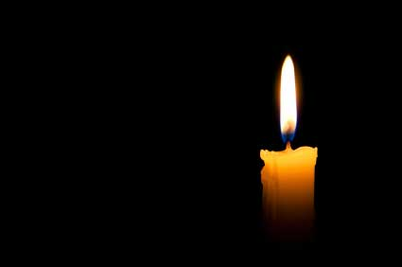
Theology of Ministry
Profound vision of who God is
Witness to the value of the human person as created in the image and likeness of God
God’s love expressed in the relationship between God and the human person

Slide 16
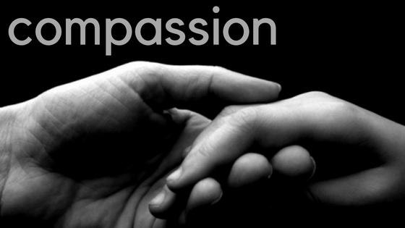
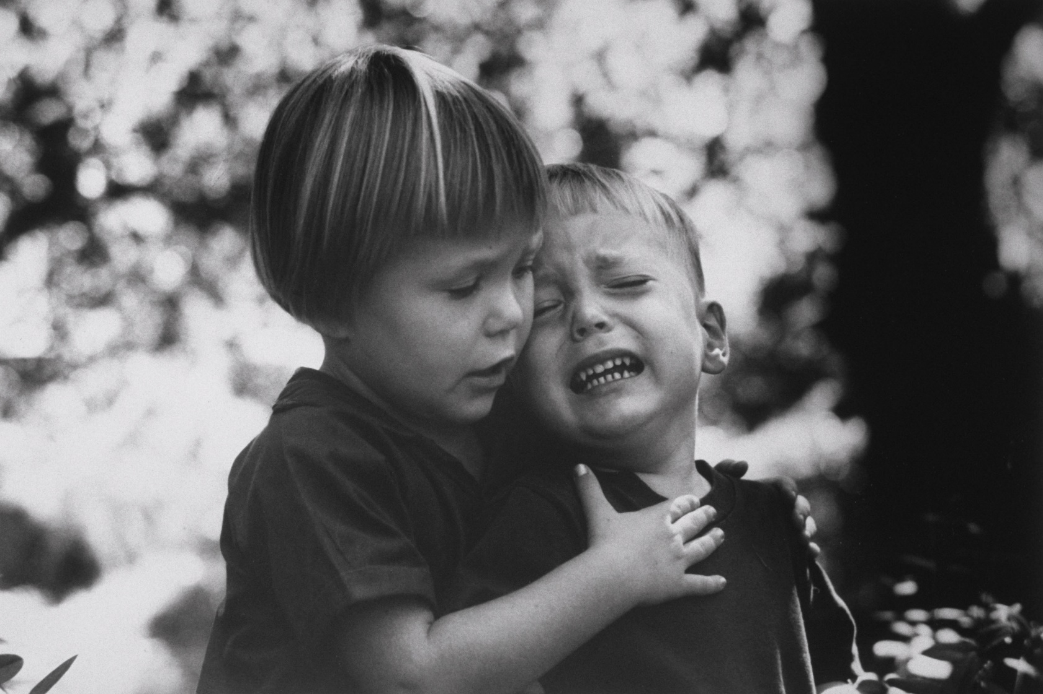
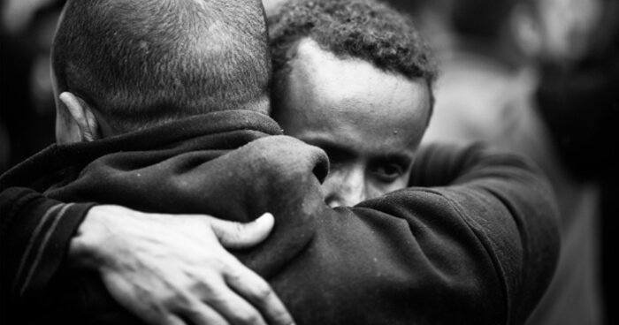

Slide 17
What is Theology
Faith seeking understanding
Our understanding of God and how God relates to us in our lived experience
Relationship with God, with ourselves and with other people

Slide 18
Feedback from Survivors
Felt betrayed by the Church
Highly negative impact of abuse on faith, family, relationship with God
Abuse perpetrated by religious personnel
By people acting in the name of the Church
By people acting in the name of Jesus Christ

Slide 19
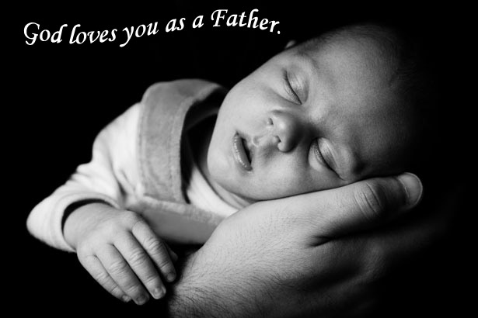
Some abused people feel
Guilt / Unworthiness / Self –blame
That God does not love them/ betrayed them
Isolated rejected and angry
Cannot relate to God as Father

Slide 20

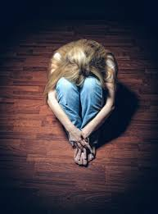

Soul Murder
Soul Murder

Slide 21
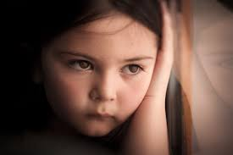

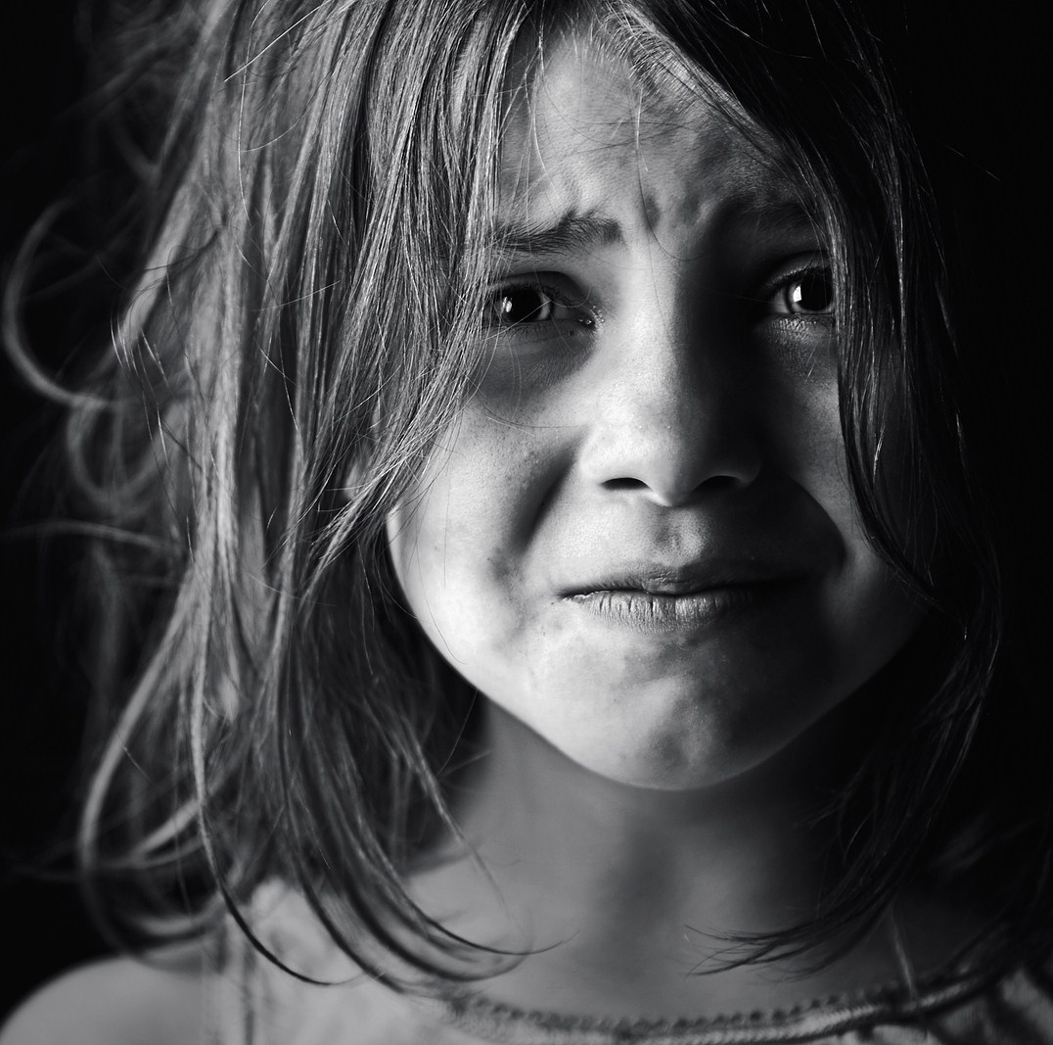
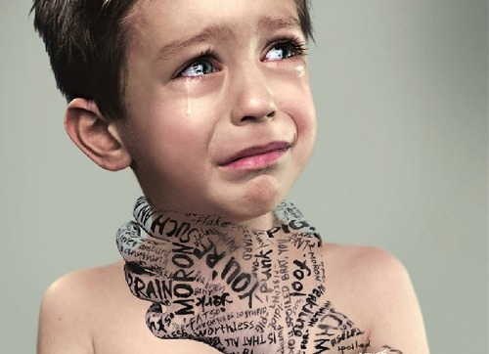

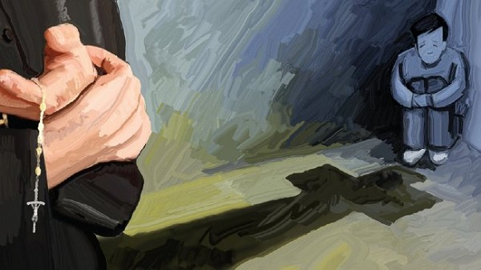

Slide 22
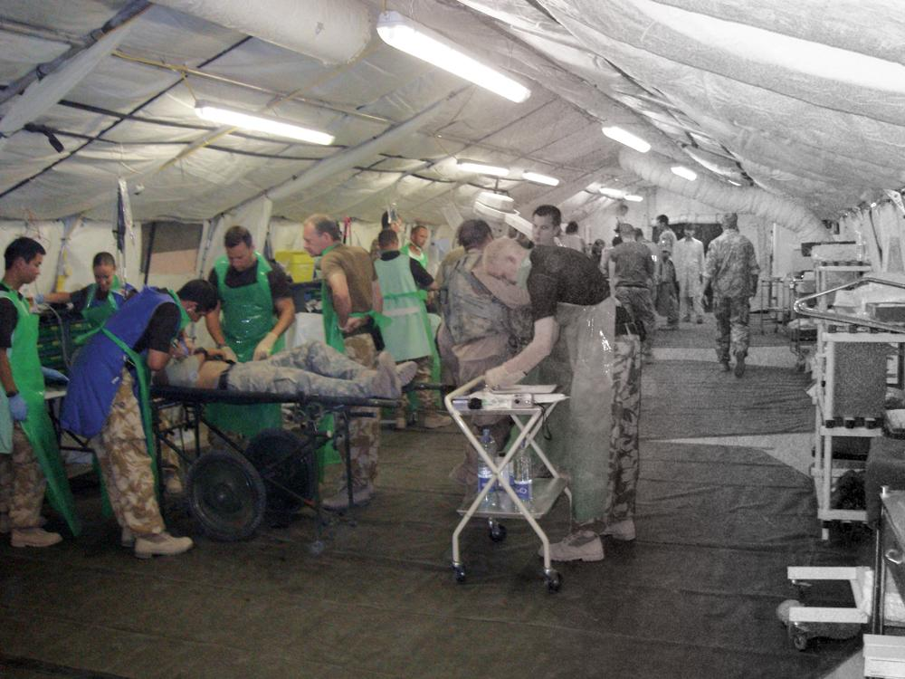
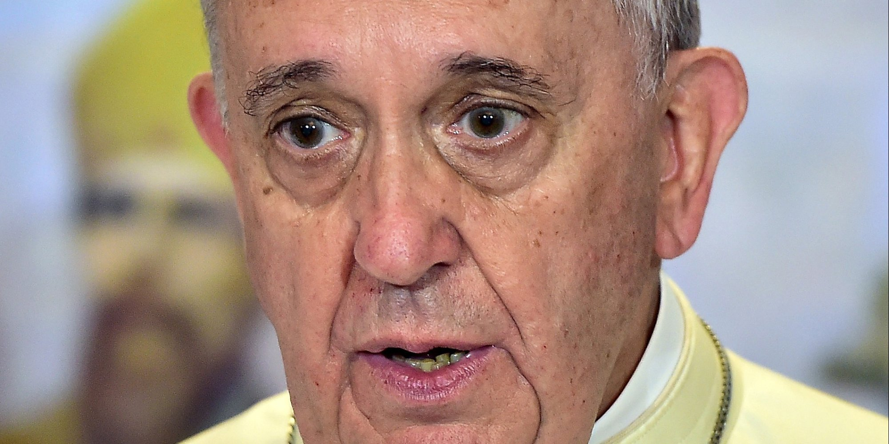


Slide 23
Theological Reflection
A way of doing theology
Starts from experiences of life
Leads to a searching for deeper meaning and
For the living God

Slide 24
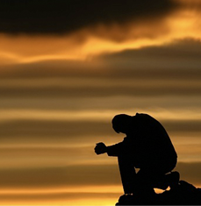
Christian Tradition
Essential to attend to inner life.

Slide 25
Christian Tradition
Essential to attend to inner life.
God is at the core of our being.

Slide 26
Christian Tradition
Essential to attend to inner life.
God is at the core of our being.
John of the Cross - Spirituality defined as how we channel that Spirit within.

Slide 27
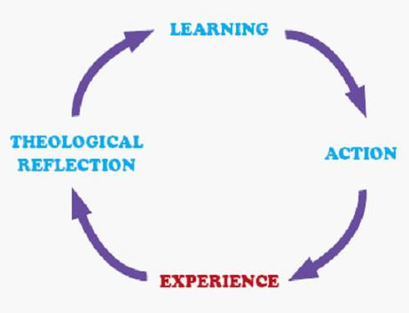
Paying Attention!

Slide 28
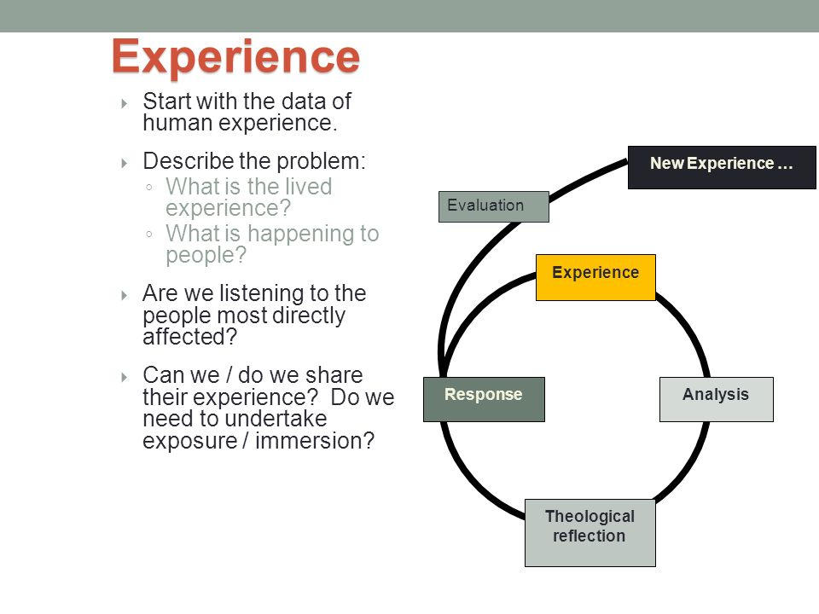

Slide 29
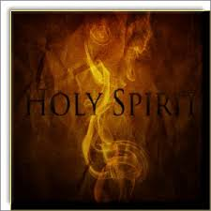
Christian Tradition
Indwelling Spirit constantly guiding moving
and motivating us.

Slide 30
Questions
Why are you here today
Why are you attending this training
What brought you here

Slide 32

E R KD A
Experience
Reflect
(Kairos Moment)
Decide
Act

Slide 33
Pastoral Theology
Concerned with achievement of Church’s full potential in the present moment
Importance of reading the signs of the times
Need to be grounded in experience attitude and reflection of the people we encounter in our work if we are to accomplish this

Slide 34
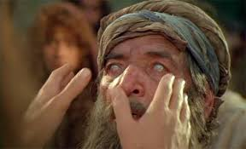
Bartimaeus – an example of how we use theological reflection

Slide 35
They came to Jericho. As he and his disciples and a large crowd were leaving Jericho, Bartimaeus son of Timaeus, a blind beggar, was sitting by the roadside. When he heard that it was Jesus of Nazareth, he began to shout out and say, “Jesus, Son of David, have mercy on me!”
Many scolded him and ordered him to be quiet, but he cried out even more loudly, “Son of David, have mercy on me!”
Jesus stood still and said, “Call him here.” And they called the blind man, saying to him, “Courage; get up, he is calling you.” So, throwing off his cloak, he sprang up and came to Jesus. Then Jesus said to him, “What do you want me to do for you?” The blind man said to him, “My teacher, let me see again.” Jesus said to him,
“Go; your faith has made you well.”
Immediately he regained his sight and followed him on the way.

Slide 36


Slide 37
BREAK

Slide 38
Restorative Justice
Working with people who have been abused
Notes:
Hi. Thank you for asking me to speak here today.
The views I express are mine, most of them are consistent with my Bishop’s, Bishop Ray but I am not speaking on behalf of the Kerry Dioceses, I am speaking from my own experience as a youth worker, then in rehabilitation working with people with disabilities. I have been fortunate to work in areas where the focus was person-centered, where finding opportunities for people to grow was central to my work, where removing obstacles and creating space for others was the reason for going to work each day.
Working in the area of disability, I was made aware of the importance of language and of labels. We moved to not using labels like invalid, the disabled, the handicapped to talking about people, people with disabilities. It was vital in the move to including people with disabilities in the task of working with them for a better life.

Slide 39
People
Pace
Place
Notes:
That’s why I think it’s important that we use the right language today.
Today is about responding to people who have been abused.
I know why we use the word “complainant” and at times it may be useful but not today because we are talking about people, people who have been hurt while in our care.
So let us start by recognising the people, the individuals to whom we now have a responsibility.
A responsibility to support them on their journey of healing / recovery / reconciliation / of realising their potential.
Because of our past failures they have suffered, their lives tarnished, how do we make amends?
The slide shows the 3 Ps. Research has shown that when we are offering support to people the 3 P’s are important to keep in mind.
People want to meet real people, not a system. The process has to be at their pace and they must be comfortable in the place where they meet. Not everyone will want to meet in the bishops offices. So meet in a place that is comfortable for them otherwise it is more difficult to meet the real person.

Slide 40
Honesty
Genuine
Truthful
Notes:
You have seen these word before.
Honesty, Genuine. Truthful. They are words we can be proud of. So
Let us not use words or phrases that mislead such as the manner in which a 'pastoral response’ has been used in the past.
Too often it meant an experience that fell well short of anything pastoral.
Often it involved a meeting with the Bishop or a senior priest, which may or may not have been a positive experience, and the offer of counselling, But if one looked for any kind of compensation or other support then they were told to go to their solicitor and take a civil action.

Slide 41
You can’t support
and
Oppose at the same time
Notes:
The implications of this are that the individual is now taking a legal action against the person who abused them and also against the Bishop or Superior who at the recent meeting said he believed you, that he was sorry, that he wanted to help. Now the same Bishop, through his legal team, is fighting against you and your claim for justice.

Slide 42
Love
Hope
Healing
Support
Notes:
How did the christen message get so lost?

Slide 43
Defend
Question
Weaken
Reduce
Notes:
And that is just the start. Now the person has to go through three to five years of justifying their past in this adversarial system where every recounted memory is doubted, is questioned and if possible dismissed.
Where you will be assessed as being of sound mind by your export witness and then have to face the Bishop’s expert witness, whose job it is to find weaknesses in your personality and this is not in order to conclude that the weakness is most likely as a result of the abuse you suffered but to show you are not as reliable as stated in the first expert report. This system is about sowing doubt and weakening the opponent.

Slide 44
Love
Hope
Healing
Support
Defend
Question
Weaken
Reduce
Notes:
That is what happens, that is the process of re-traumatisation that can be inflicted when we limit the options and fail to respond to the individual’s needs.
Is that what we believe compassion to be?
Is this following the Christian message?
Is this about truth and justice?
At this point I believe each of you need to ask yourselves these questions
Which of the lists above represent; compassion, the Christian message, justice?
This is something You have to decide, what is your belief.
I had to ask myself these question when I took up the post as DLP in Kerry.

Slide 45
Meeting people
Listening to their story
Justice
Notes:
As soon as I started working in the Kerry Diocese as DLP, I started reviewing the files and was uneasy, this response, it just felt so wrong. My way of working is to meet people when I can, no to just read the files. Because I believe without meeting people you don’t get the full story.
Very quickly I saw how wrong it was and how it further traumatising the individual.
It was unjust as it pitted a vulnerable person against the strength of the Diocese, and it denied one of the most basic beliefs of our society, that we use money to show how we value things. We pay people to work, we reward people with monetary gifts, we assign monitory value to things we see as important or as valuable...

Slide 46
40% to legal fees
Notes:
At the same time the Diocese was willing to pay their legal team to fight the legal battle. It was the practice to follow legal advice rather than, I my view, being willing to take responsibility for working with the individual to see how they might be assisted & supported.
In Kerry 40% of the payments made in respect of abuse cases has gone to solicitors. How many more people could have been assisted in a tangible way if a different approach was taken?
For the people who persevered and did survive the 3 to 5 year torment and get to court, the case would most likely be settled on the steps of the court, so that no negative publicity would impact on the Church.
After all the effort you will get a settlement but you don’t get your day in court.

Slide 47
Is there a better way?
Notes:
I was lucky, because when I raised these issues and questioned the approach my Bishop was not just willing to listen, he asked me to get a group together to seek an alternative approach that would be just and fair. The group consisted of a Banister, a Mediator, two priests, the Bishop and myself. Together having looked at different approaches and discussed their pros and cons, we developed our approach for responding in a healing manner.

Slide 48
Restorative Justice
Notes:
This approach was based on the restorative justice model of seeking to work with the person in a way that supported them to heal, to feel valued, to start to come to terms with their past in the hope of a better future.
Our approach is not perfect but it is a significant step in the right direction and sadly it comes too late for many, many who sought redress through the old system. Unfortunately for many that system defeat them, cause them more pain and drove them further away from healing or recovery.

Slide 49
Direct personal response
Counselling and Psychological care
Compensation
Notes:
I have been very heartened recently by the developments in Australia where the Royal Commission investigating child abuse has recently reported. Not only has it reported on the level of past abuse within the country but it has also set out what must happen in response. For me they have identified what a compassionate response must include.
This is a condensed version that was highlighted in the GAP paper earlier.

Slide 50
Truth and Justice
A compassionate Response
Notes:
Last month the Australian government accepted the findings of the Commission and all states and most institutions involved have signed up to implementing the main findings of the Commission. Not everybody is happy but it is clearly many steps in the right direction. It involves a comprehensive response that is about truth and justice. Is there a distinction between truth and justice and a compassionate response, if so I am in favour of truth and justice.

Slide 51
Leadership
To always
promote best practice
Notes:
So for me the Church and our Bishops/ Superiors need support, they need to be challenged in a way that emphasises truth and justice. That is not to put anyone down but to lead through presenting the argument in a manner that makes sense. An argument that has at its core, the valuing of people, making restitution, promoting healing, promoting best practice.
For me this is consistent with the role of the DLP and others involved in safeguarding, as our work must be about continuous improvement, about reviewing what we do and asking if we can do it better?

Slide 52
Person centered
Flexible
Working together
Notes:
Implementing such a response involves a number of stages that must be unique to each individual case. There can be a framework but there cannot be a rigid process where the person involved has to fit into a system designed to suit the diocese or the order.
It must be flexible and at the persons pace.
It about listening and being with that person.
The first phase is the one we are all familiar with, its the more formal gathering of information and reported to the authorities. It involves:
Listening to the allegation
Examining its reliability - is it credible / not obviously false
Reporting it to the authorities
Inform the respondent
The second phase for me is about:
Identifying with the person how the dioceses can now support them and will involve discussing
A possible meeting with the Bishop and how to prepare for this
The options for Counselling / psychological support
And Compensation - in what other ways can the Diocese assist and support at this time.
This phase must be progressed at a pace that suits the person, it might involve meetings with a mediator where certain matters cannot be agreed. It may involve providing other information to answer questions the person has raised. It must help to assure the person that best safeguarding practice is now in place to do everything possible to avoid a repeat of what happened to them.
Where financial support is involved we have a legal document that the person brings to their own solicitor before signing, to ensure they have independent advice.
Its not an easy path but for me its the right one.

Slide 53
What did you think when you realised what had happened?
What impact has the incident had on you and on others?
What was the hardest thing for you?
What do you think needs to happen to make things better?
Notes:
These four questions give that framework, they are taken from a restorative justice model.
Terry O’Connell - the Cop from Waga Waga. Real Justice real justice.org
They can be asked in different ways but they give a structure to the engagement.
Because the work to support the individual in moving from
The events What was the event like for you?
The impact. What was the key impact on you and others?
How they coped/ are coping. What was the hardest part for you?
The future. What needs to happen now?
Asking the person what they feel should happen now shows trust in them,

Slide 54
It’s not about money
It’s having the right agenda
That the person can select from
Notes:
It’s not about money
It’s having the right agenda, That the person can select from.
Some will choose all the options
Many will not look for financial compensation
Most will want a sincere apology from the Bishop or Superior
Many will want counselling, others may have paid for counselling and be happy to have their expenditure refunded.
The most important thing is that the person involved has control of what is important to them and the Diocese is not dictating or limiting the agenda.

Slide 55
A Counsellor's Experience of working with complainants
Lynda Ryder

Slide 56
LUNCH

Slide 57
Group Work

Slide 58
What do you think needs further developed within the Church in terms of a compassionate response?
How can the National Board assist with this work?
Any questions for the panel?

Slide 59
Evaluation and Close

