Slide 1
Leaders Training
21st February 2018

Slide 2
Welcome, Introductions and Prayer
Teresa Devlin

Slide 3
Aims for the Day
To discuss the strategic role of the Church Authority in terms of governance and identify challenges associated with your role
To discuss recent changes following enactment of the Children First Act 2015
To discuss the importance of a pastoral approach in working with complainants

Slide 4
Questionnaire

Slide 5
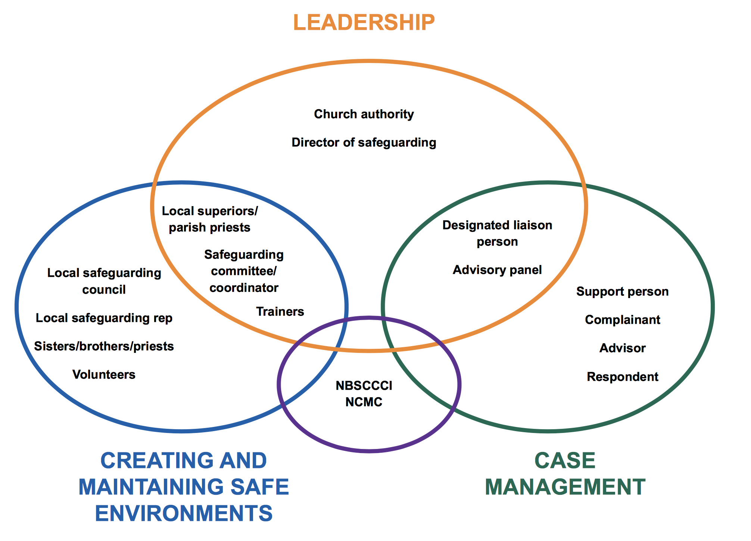

Slide 6
Role of the Church Authority
To be responsible for all safeguarding practices by:
• Ensuring that the appropriate child safeguarding structures and personnel are in place;
• Liaising with the Holy See, as appropriate. If the Church body is a religious order or congregation, this is done through the superior general;
• Ensuring compliance with canon and civil law;
• Upholding the seven standards in practice and behaviour.

Slide 7
Support

Slide 8
Who needs support?
Complainant
Respondent
Congregation
Safeguarding Personnel
You

Slide 9
What kind of support?
Complainant- Towards Healing, Toward Peace, Support Person
Respondent- Counselling, Adviser
Congregation- Counselling
Safeguarding Personnel – Supervision
You - Supervision

Slide 10
Challenges
How is it resourced?
How is confidentiality maintained?
Difficulty in trust?
How are objectives set and achieved?

Slide 11
Bullet Point 1 and 4- Upholding the Standards and ensuring the safeguarding Structure is in place

Slide 12
Terminology, Website and App
Terminology used throughout this presentation and where it can be found in the Policy and Standards document
Policy is pages 8-12
Policy Statement is the first two paragraphs of page 8. The wording of these paragraphs cannot be changed or adapted in any way.
Standards are set out on page 13
Indicators are the standards broken down and are grouped into 3 categories:
  Ministry with children (Table 1) page 16
  Those with no ministry with children but are managing cases (Table 2) page 18
  Those with no ministry with children (Table 3) page 20
Procedures are the written documents you need to help assist with practice to live out the indicators of the standards. The guidance can help you to do this, if you need it.
Guidance is support for all aspects of safeguarding children and is there to assist if necessary

Slide 13
Ministry with Children
Any work or service undertaken by Church Personnel with children, which is under the authority of their church body
Any work with children undertaken by Church personnel (lay, vowed and ordained) within Church property, which is under their authority of their Church body;
All priests in active ministry under the authority of their Church body are to be considered as having ministry with children.

Slide 14


Slide 15
Church Authority-Procedures Needed
Access to all procedures relevant to Church body you can see the full list here https://www.safeguarding.ie/index.php/guidance-by-roles
In particular:
  Three year safeguarding plan (for those in Categories 1 and 2) (7.2A) this includes
    Training Plan (5.2B)
    Communications Plan (6.1A)
  Procedure for annual report to Church Authority (7.1D)
  Notification letter to NBSCCCI (7.1 Template 4 or 5)
  List of all clerics/religious ministering outside of the Church body (1.10A)
  Procedure for Information Sharing (2.3A)
  Procedures to support complainant (3.1A, 3.2B, 3.3A)

Slide 16
Church Authority- Procedures Needed
  Procedure for Informing Respondent (4.2A)
  Conducting a risk assessment to produce interim management plan (4.2B)
  Canonical Processes (4.2C, 4.3A, 4.3B, 4.3C, 4.3D, 4.3E, 4.4A, 4.4C)
  Procedure for clinical risk assessment (4.4B)
  Procedure for accessing support (5.6A)
  List of Mandated Persons (2.1L)
  Child Safeguarding Statement (For those who have ministry with children) (6.1D)
  Reporting Procedure (2.1A)
  Visiting Clergy/religious procedure (1.1C)

Slide 17
Visiting Clerics and Religious-Procedure
Teresa

Slide 18
Visiting Clerics/Religious from within Ireland
Once off cover
Be vetted in own Church body
Show celebret/current letter of good standing
Sign the Sacristy Register (or visitors book)
Short Term Cover
Be vetted in own Church body and receiving jurisdiction
Show celebret/current letter of good standing which requires approval of ministry forms to be completed
Confidential Declaration form
Induction Agreement

Slide 19
Visiting Clerics from outside Ireland
Once off cover
Be vetted in own Church body if possible
Show celebret/current letter of good standing
Sign the Sacristy Register (or visitors book)
Short Term Cover
Be vetted in own Church body and receiving jurisdiction
Show celebret/current letter of good standing and approval of ministry.
Confidential Declaration form
Induction Agreement

Slide 20
Clerics from Outside Ireland
Prior to visit, where there is an intention to engage in public ministry, all visiting clerics must write seeking permission of the Church authority, giving details about the duration of the visit, the type of ministry and the location of ministry being considered. The contact details of the Church authority of the visiting priest must be provided in advance;
Upon receipt of a request from visiting clerics to carry out ministry, the Church authority must acknowledge the same, and then make a request in writing to the visitor (1.1C Template 1) for a celebret or confirmation of good standing (1.1C Template 3), signed by their Church authority;
The visiting cleric must be asked to complete a declaration of good standing form (1.1C Template 2);
A vetting check must be carried out through the Garda National Vetting Bureau/Access NI (Guidance 1.1B);

Slide 21
Visiting Cleric from Outside Ireland
If the Church authority is satisfied that there are no concerns about the visiting cleric, permission should be given in writing to the visitor, outlining the specified ministry, including its duration and location (1.1C Template 4);
A copy of this permission (1.1C Template 4) should be forwarded to the parish priest or local superior of the visitor, and also to the parish priest or local superior of the location of the ministry outlined in the letter;
A copy of the permission (1.1C Template 4) should be stored in the offices of the Church authority, in line with confidentiality and storage of information (Appendix B).

Slide 22
Visiting Person in any form of consecrated life
Prior to their visit, where there is an intention to engage in public ministry, all visiting religious must write seeking permission of the Church authority, giving details about the duration of the visit, the type of ministry and the location of ministry being considered. Contact details of the Church authority of the visiting religious must be provided in advance
Upon receipt of request from the visiting religious to carry out ministry, the Church authority must acknowledge the same, and then make a request in writing to the visitor (1.1C Template for a confirmation of good standing (1.1C Template 5), signed by their Church authority;

Slide 23
Visiting Person in any form of consecrated life
A vetting check must be processed through the Garda National Vetting Bureau/Access NI (Guidance 1.1B);
If the Church authority is satisfied that there are no concerns about the visiting religious, permission should be given in writing to the visitor, outlining the specified ministry, including its duration and location (1.1C Template 4);
A copy of this permission (1.1C Template 4) should be forwarded to the parish priest or local superior of the visitor, and also to the parish priest or local superior of the location of the ministry outlined in the letter;
A copy of the permission (1.1C Template 4) should be stored in the offices of the Church authority, in line with confidentiality and storage of information (Appendix B).

Slide 24
Other Variations
See Handout

Slide 25
Break

Slide 26
Ensuring Compliance-Procedure
Niall

Slide 27
Indicator 7.1
The Church authority:
Puts in place arrangements to ensure and evaluate its compliance with the safeguarding Standards at a local level;
Produces a report on the level of compliance established through this audit exercise
Notifies the National Board in writing of this annual audit report

Slide 28
Bullet Point 1
Compliance at a local level is achieved through the following:
Ensuring that a local safeguarding audit is completed depending on your level of ministry with children and a report of the findings produced. (7.1C Templates1,2 or 3)
If you have cases, ensuring that a report is completed of all active cases by your DLP (7.1D Template 1)
If appropriate conducting monitoring visits (7.1B)
Having a clear induction process for new leadership or staff (7.1E)

Slide 29
Bullet Point 2
Producing Reports

Slide 30
Bullet Point 3
Once the report from DLP and report from Safeguarding Committee are received the Church Authority writes to the National Board to say that the local audit is completed and plans to address any gaps are in place.
Template letters for those that are in Table 1 or 2 of the policy – 7.1C Template 4
Template letter for those that are in Table 3 of the policy - 7.1C Template 5

Slide 31
Indicator 7.2 (Ignore if you have no ministry or cases)
The Church body produces a three year safeguarding plan
Guidance for this is contained in 7.2A Template 1
The plan should outline the actions identified from the local safeguarding audit and how these should be addressed

Slide 32
Bullet Point 2 and 3-Ensuring Compliance with Civil and Canon Law
Niall Moore

Slide 33
Liaison with statutory authorities – notification of allegations and regular meeting (Ferns report);
MOU with The National Board
Notification of allegations to the National Board
Liaison with the Holy See – to CDF or Congregation for Religious
If a religious through the Superior General

Slide 34
New Changes Following Children First 2015
Niall Moore

Slide 35
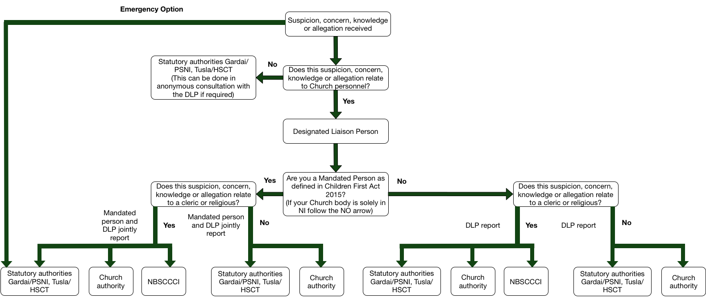

Slide 36
Mandated Persons
Mandated persons (as defined in the Children First Act 2015) are people who have contact with children and/or families and who, because of their qualifications, training and/or employment role, are in a key position to help protect children from harm
Each Church body should consult the full list of categories who are classified as mandated persons under Schedule 2 of the Children First Act 2015 to establish which members of Church personnel are classified as mandated persons

Slide 37
Mandated Persons
It should be understood that:
All clerics and religious who have any ministry are to be considered mandated persons
Volunteers are not mandated persons under the Children First Act 2015. However DLPs or Deputy DLPs who are volunteers are classed as mandated persons under Church standards.

Slide 38
Mandated Persons
On completion of this process the Church authority must retain a list of all mandated persons, and ensure this is kept up to date. In developing this list Tusla have advised that there should be a clear statement of the type of roles that a Church body are listing as mandated persons then a number of mandated persons that are in the Church body against each role. For Example
  Clerics (25),
  Pastoral Workers (50),
  Religious (15) etc).
For more information see Guidance 2.1L

Slide 39
Child Safeguarding Statement
POINTS TO CONSIDER
This only applies if you have ministry with children and are in the Republic of Ireland.
It is a requirement of Tusla and the Children First Act 2015, it does not replace our existing policy

Slide 40
Child Safeguarding Statement
WHAT I HAVE TO DO
Appoint a Relevant person- these are contact people for any questions regarding the Child Safeguarding Statement
Produce the Statement- we have written one for the whole Church which you can adapt it’s available here https://www.safeguarding.ie/images/Pdfs/StandardsDocs/6.2D%20Template%201%20Example%20Child%20Safeguarding%20Statement.doc
Make it available on your website and email it to all Church personnel by the 1 11th of March 2018- this is a requirement of the Children First Guidance.

Slide 41
What do we mean by a
pastoral response?
Teresa Devlin

Slide 42
What Survivors Ask For
Listened to and believed, a place to tell their story with compassion
Apology & Acknowledgement
Counselling/Support
Assured of Safeguarding
Compensation for harm
Normalising their reaction to harm (Groups)

Slide 43
DO’s
Do what you say you will do
Tell them what you will do
Consider Lay Person as DLP
Do meet face to face, not over telephone
Do check out where the survivor is comfortable to meet (therapist’s rooms/meeting room)
Do check if it is OK to wear clerical clothing, respect if it is not
Keep in touch/ provide updates
Give information for Support (Towards Healing/Towards Peace)
Listen, Really Listen

Slide 44
DO’s
Do understand it is a process, at one point the survivor may be too full of rage to engage, this might change, welcome them to have contact if and when they are ready
Understand the rage and pain is a normal response (do not take it personally)
Keep the communication simple/plain English/user friendly
Continue to offer funding for support service
Work with civil authorities (Gardai/PSNI/Tusla/HSC): Follow up
Do make it easy for a survivor to find the DLP on the web

Slide 45
Don’ts
Do not get defensive/Legalistic
Do not back away from rage, pain, depression
Do not see the “full and final settlement” as a closed case: continue to offer pastoral support
Do not use the word “psychotherapy”; they may find this scary; “you are crazy”
Do not forget survivors are human, just hurt
Do not make a survivor “beg” for support or funding for support

Slide 46
Lunch

Slide 47
Management of Allegations- Zero Tolerance or Redemption
Teresa Devlin

Slide 48
Notification of all allegations
Consider Restrictions on Ministry
Seek advice – Advisory Panel/NCMC
Conclusion of statutory investigations
Preliminary investigation
Interim Management plan/Permanent Management Plan

Slide 49
Considerations on Restrictions to Ministry
What information do you have?
What is the current ministry of the respondent?
What are the risks?

Slide 50
Case Examples
An allegation has been received against Brother John through Towards Healing. The information states that Gerard Green alleges he was sexually abused by Brother John in 1984 when Gerard was 12. There are no more details.
What are the issues that you should consider?
Should Brother Johns Ministry be restricted?

Slide 51
Scenario 1
Father John has been out of ministry for 5 years. As the new Bishop you have been asked by him to review his case as he would like to return to ministry.
Background
In 2011 an allegation that Father John abused Clare in 1980 – she was aged 13 at the time of the alleged abuse. The abuse consisted of kissing her on the mouth when he was drunk; it is alleged to have happened on several occasions. Clare did not wish to pursue a criminal investigation.
Father John was a heavy drinker at the time, but has been dry for 20 years. He doesn’t remember whether it happened or not.
Preliminary investigation
The preliminary investigation has concluded that it is probable that the incidents happened
Other Information
Fr John is aged 67; there have been no other allegations against him

Slide 52
Scenario 2
Fr Michael was removed from ministry following an allegation, that was made against him that he touched the privates of a 16 year male old in a swimming pool 10 years previous. Fr Michael admitted to a number of adult male relationships but claims he is now celibate and has been for the past 5 years. He states that the incident with the 16 year old may have happened but he mistook him for an 18 year old.
Preliminary investigation
The preliminary investigation has concluded that it is probable that the incidents happened
Other Information
Fr Michael is aged 57; there have been no other allegations against him

Slide 53
Scenario 3
Fr Jack admitted that when he was 27 he had a sexual relationship with a 16 year old girl. You have removed him from ministry.
The girl in question has not pursued a criminal investigation.
Preliminary investigation
The preliminary investigation has concluded that the relationship took place.
Other Information
Fr Jack is aged 50; there have been no other allegations against him

Slide 54
Questions and Evaluation

