Slide 1

Risk Assessment and Audit Training
20th September 2022

Slide 2
Welcome and Prayer
Teresa

Slide 3
Aims
Understanding the localised risk assessment process and template
1
Exploring best practice in carrying out the safeguarding audit and DLP report
2
Exploring together alternative ways of ensuring compliance
3

Slide 4
Discussion
What are the challenges you face in relation to risk assessment?
What would you like to get out of this session today?

Slide 5
What do we mean by risk assessment?

Slide 6
Republic of Ireland Definition
A risk is a potential source of harm or adverse health effect on a person or persons. In the Republic of Ireland ‘Risk’ in the context of this risk assessment is the risk of harm to children
as defined in the Children First Act (2015) – (a) assault, ill-treatment, or neglect of the child in a manner that seriously affects or is likely to seriously affect the child`s health, development or welfare, or (b) the sexual abuse of a child whether by a single act, omission, or circumstance or by a series or combination acts, omissions or circumstances, or otherwise.

Slide 7
NI Definition
In Northern Ireland, Co-Operating to Safeguard Children and Young People in NI takes its definition from the Children (NI) Order 1995 which defines ‘harm’ as ill-treatment or the impairment of health or development. It states that ‘ill-treatment’ includes sexual abuse, forms of ill-treatment which are physical and forms of ill-treatment which are not physical; ‘health’ means physical and / or mental health; and ‘development’ means physical, intellectual, emotional, social or behavioural development.

Slide 8
Why is risk assessment relevant?

Slide 9
Principles
Leadership, governance and a culture which all recognise the importance of child safety and children’s wellbeing.
Children and young people are informed about their rights, participate in decisions affecting them, and are taken seriously.

Slide 10
Pope Francis
Our generation will show that it can rise to the promise found in each young person when we know how to give them space. This means that we have to create the material and spiritual conditions for their full development, by giving them a solid basis on which to build their lives, guaranteeing their safety and education so that they develop their full potential, and passing on to them lasting values that make life worth living.

Slide 11
Principles
Respect for the views of children

Slide 12
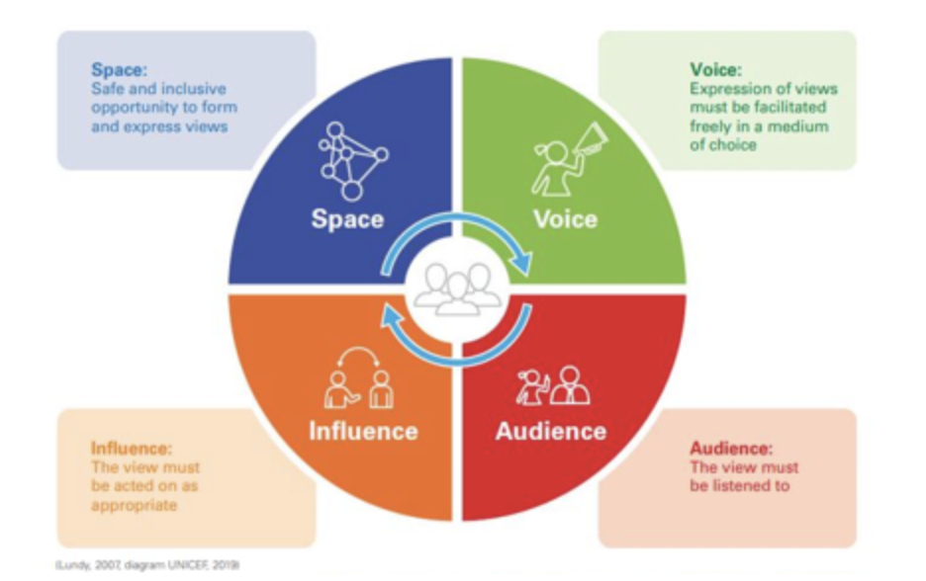
Article 12- as a framework for risk assessment
Taken from https://www.our-voices.org.uk/news/2021/working-reflexively-to-foster-childrens-safety-in-violence-research

Slide 13
Principles
A positive value base
People are required to demonstrate their aptitude and commitment to keeping children safe.
People in ministry recognise the need to understand how to keep children safe through training.
There are clear safety measures in place which are understood and followed.
Information about the steps being taken to safeguard children is communicated openly and extensively.

Slide 14
Policy Indicator 1.8

Slide 15
Tusla Child Safeguarding Statement
The Child Safeguarding Statement should provide an overview of the measures that the Church body has in place to ensure that children are protected from harm. It should also include and refer to more local hazard assessment procedures which can be made available on request.
The statutory requirement to have a Child Safeguarding Statement does not eradicate the need for the Church body’s Child Safeguarding Policy and its associated procedures or guidance, but it should make reference to the Safeguarding Policy.

Slide 16
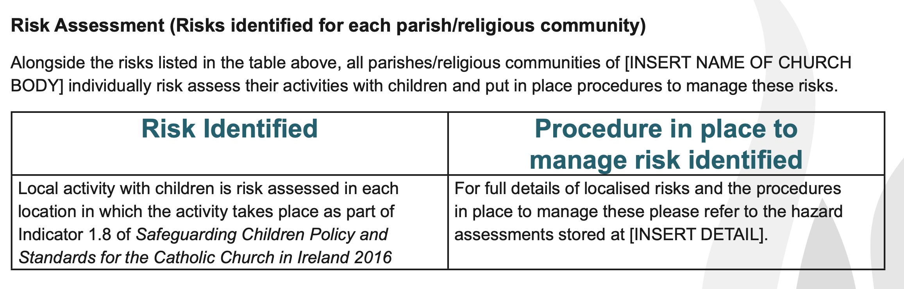
Child Safeguarding Statement

Slide 17

BREAK

Slide 18
Group Work

Slide 19
In your groups read through the scenario and discuss
What are the safeguarding risks?

Slide 20
Looking at each of the risks you have identified, what are the measures needed to manage the risks?

Slide 21
How would you ascertain, review or evaluate whether the measures to manage risks were successful?

Slide 22
Risk Assessment Template

Slide 23
Having gone through the process of risk assessment what do you feel would assist in encouraging effective risk assessment at local level?

Slide 24

LUNCH

Slide 25
Audit
Teresa Devlin

Slide 26
Indicator 7.1
The Church authority:
Puts in place arrangements to ensure and evaluate its compliance with the safeguarding Standards at a local level;
Produces a report on the level of compliance established through this audit exercise
Notifies the National Board in writing of this annual audit report

Slide 27
Bullet Point 1
Compliance at a local level is achieved through the following:
Ensuring that a local safeguarding audit is completed depending on your level of ministry with children and a report of the findings produced. (7.1C Templates1,2 or 3)
If you have cases, ensuring that a report is completed of all active cases by your DLP (7.1D Template 1)
If appropriate conducting monitoring visits (7.1B)
Having a clear induction process for new leadership or staff (7.1E)

Slide 28
Bullet Point 2
Producing Reports

Slide 29
Bullet Point 3
Once the report from DLP and report from Safeguarding Committee are received the Church Authority writes to the National Board to say that the local audit is completed and plans to address any gaps are in place.
Template letters for those that are in Table 1 or 2 of the policy – 7.1C Template 4
Template letter for those that are in Table 3 of the policy - 7.1C Template 5

Slide 30
Indicator 7.2
The Church body produces a three-year safeguarding plan
  Guidance for this is contained in 7.2A Template 1
  The plan should outline the actions identified from the local safeguarding audit and how these should be addressed.

Slide 31
Discussion and Feedback
Teresa Devlin

Slide 32
FINISH

