Slide 1
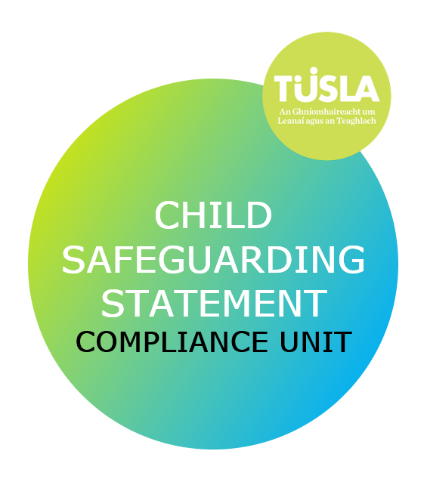
Maria McGloughlin
CSSCU@tusla.ie

Slide 2
What is a Child Safeguarding Statement?
Written statement that specifies the service provided to children & provides an overview of the measures in place to protect children from harm within the service

Slide 3
Who has to have a child safeguarding statement?
Works with children
More than one worker or volunteer
Every Organisation
Relevant service
Provider of a relevant service
Notes:
Every organisation, where more than one person works with children in a voluntary or paid capacity, is required by law to develop a child safeguarding statement. Under the Children First Act 2015 these organisations are called Relevant Services, and the person in charge is called the Provider of a Relevant Service.

Slide 4
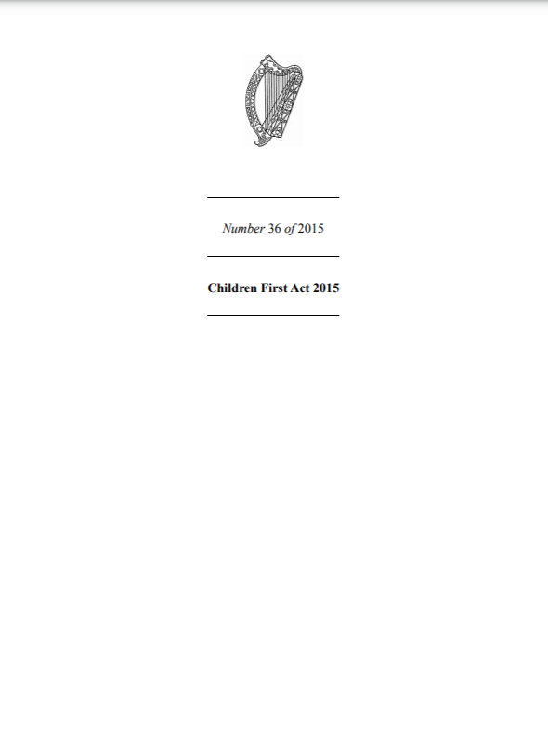
Legislation
Notes:
Passed in 2015 and fully commenced Dec 2017
Five parts.
Part 2 – CSS
Part 3 Mandated Persons
Part 4 Government Departmental responsibilities and IDIG

Slide 5
Definition of Harm
assault, ill-treatment or neglect – that seriously affects or is likely to seriously affect the child’s health, development or welfare,
OR
sexual abuse - caused by a single or series of acts, omissions or circumstances
whether caused by a single act, omission or circumstance or a series or combination of acts, omissions or circumstances, or otherwise.
Notes:
The legal definition of ‘harm’ is what a mandated person will use to decide if they are making or a mandated report (under the Children First Act) or a report of a reasonable concern (under the National Guidance).
“Harm” means, in relation to a child:
(a) assault, ill-treatment or neglect of the child in a manner that seriously affects or is likely to seriously affect the child’s health, development or welfare, or
(b) sexual abuse of the child,
whether caused by a single act, omission or circumstance or a series or combination of
acts, omissions or circumstances, or otherwise.

Slide 6
What is required to be on a Child Safeguarding Statement?
The ‘risks of harm’ that a service has identified as potentially being a risk to a child while in their care, and the procedures in place to reduce those risks.
Name of the service, the services being provided and principles to be followed to ensure that children are safe from ‘harm’ when attending services.
Child Safeguarding Statement
The specified procedures as set out in the Children First Act 2015.
Name and contact details of the appointed ‘relevant person’ with who we can liaise, at the end of the CSS.
Notes:
A list of procedures. As well as the procedures included in the risk assessment, the Children First Act also lists six procedures that must be listed in a Child Safeguarding Statement.
A procedure for responding to any allegations against someone who works or volunteers in your service.
A procedure to make sure the people who work or volunteer in your organisation are suitable to work with children.
A procedure for making sure workers and volunteers have information and training on what child abuse is and how they might recognise it.
A procedure that says how any child protection or welfare concerns will be reported to Tusla.
A procedure that explains how you will keep a record of who in your organisation is a mandated person in your service.
And, a procedure to appoint someone to be a first point of contact for your child safeguarding statement. This person is called a “relevant person”.

Slide 7
Child Safeguarding Compliance Unit
Children First Act (2015)
Maintaining Register
Unit Established March 2018
Compliance Support & Enforcement
Notes:
The CSSCU was established under the Children First Act 2015. The Act allowed three months from commencement for existing providers to have CSS in place. Any newly established service has three months from commencing operations to have a CSS in place. The CSSCU is responsible for maintaining a register of non-compliance on behalf of Tusla. We also provide support to providers in developing CSS and have enforcement functions where we receive unsolicited information relating to a relevant service’s CSS.

Slide 8
Role and Function of CSSCU
Screen and review
Effective partnerships and communication pathways
Unsolicited Information
Enforcements and Public Register
Notes:
To screen and review Child Safeguarding Statements, adopting a supportive compliance approach.
Referrals received through
voluntary submissions by providers
Unsolicited Information
Implementation Reviews
Referred by colleagues within TUSLA
Identification, establishment, maintenance of with key stakeholders.
This is to support the stakeholders in achieving compliance and to work in partnership with relevant services
Receive and process from public and referrals from partner organisations.
Unsolicited information is risk assessed and addressed to prioritise safety to children
Initiates and maintains the public Register of Non-Compliance
In the event of services failing to engage or amend their statement sufficiently to achieve compliance the CSSCU has the responsibility for initiating enforcement proceedings and maintaining the Public Register of Non-compliant services

Slide 9
Enforcement
THE CSSCU TAKES A SUPPORTIVE COMPLIANCE APPROACH TO ENFORCEMENT
THIS MEANS THAT EVERY EFFORT IS MADE TO ASSIST RELEVANT SERVICES IN DEVELOPING AN UNDERSTANDING OF THEIR RESPONSIBILITIIES UNDER THE CHILDREN FIRST ACT 2015

Slide 10
ENFORCEMENT CONTINUED
THE CSSCU OPERATES FROM A POSITION OF DETERENCE – THAT IS THAT THE REGISTER OF NON-COMPLIANT SERVICES SERVES TO MOTIVATE RELEVANT SERVICES TO ACHIEVE COMPLIANCE
THE CSSCU ADOPTS A POSITION THAT SERVICES FOR CHILDREN ARE VITAL TO HEALTHY DEVELOPMENT AND SO SEEK TO ENCOURAGE SERVICE TO ENSURE THAT THEY ARE COMPLIANT WITH CHILDREN FIRST AND THAT CHILDREN ARE SAFE WHILST USING THEIR SERVICES

Slide 11
PUBLIC REGISTER
THE CSSCU HAS STATUTORY RESPONSIBILITY FOR THE MAINTENANCE OF THE PUBLIC REGISTER OF NON-COMPLIANT RELEVANT SERVICES
THERE ARE CURRENTLY NO SERVICES ON THIS REGISTER
FOR A SERVICE TO BE ON THE PUBLIC REGISTER OF NON-COMPLIANCE THEY WILL HAVE BEEN THROUGH A PROCESS OF ESCALATION AND NOTIFIED OF THE ESCALATION PROCESS AT EACH JUNCTURE

Slide 12

Q&A
csscu@tusla.ie

