Slide 1
Participating with Young People to Communicate the Church’s Safeguarding Message
Young people nominated by the Sisters of Mercy Northern Province

Slide 2


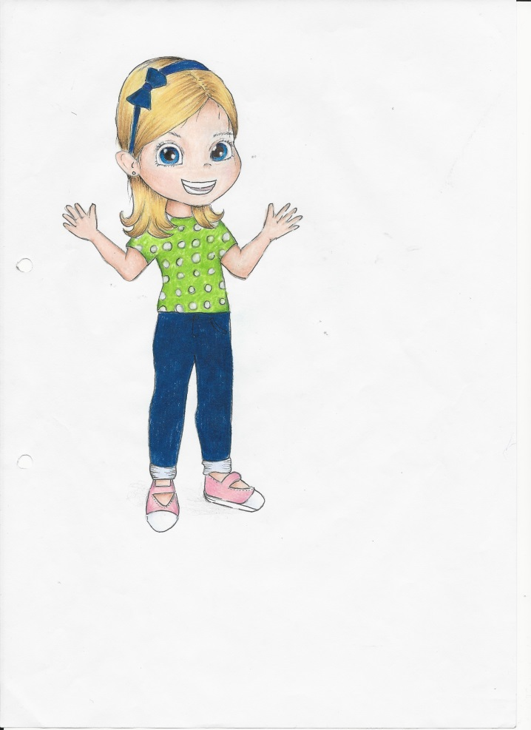
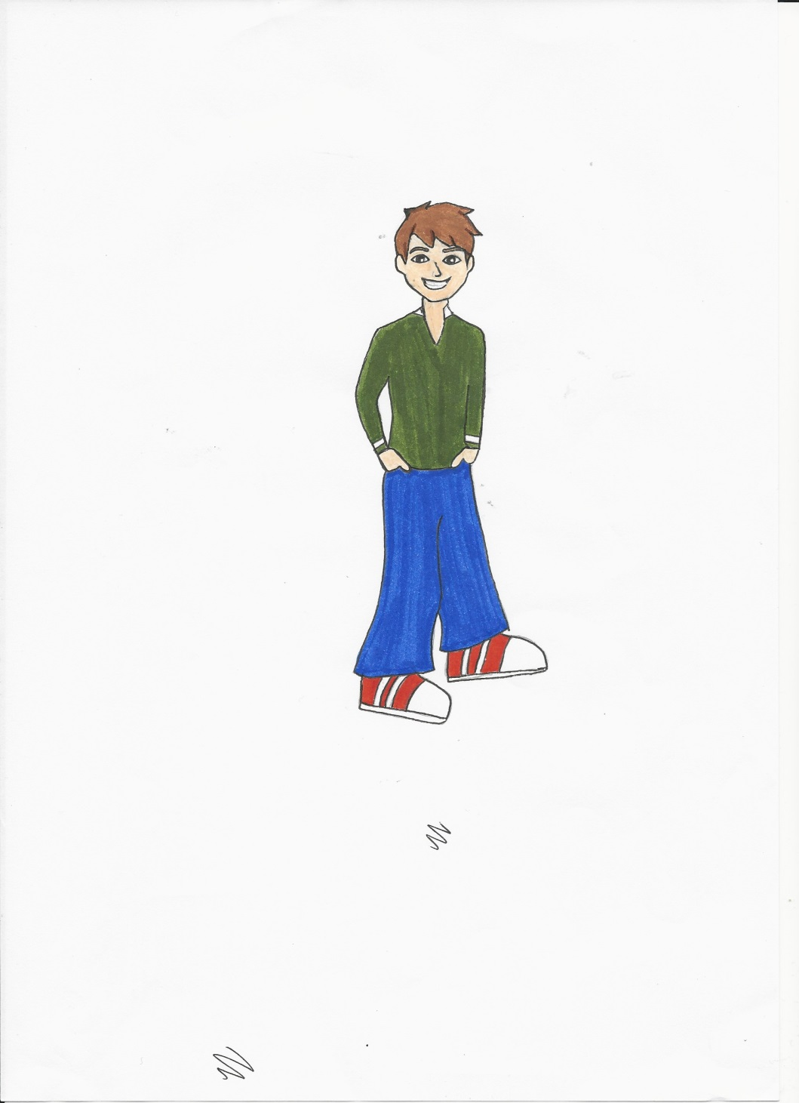

Safeguarding Young People
Sisters of Mercy
Northern Province
LEAFLETS AND POSTERS DESIGNED AND COMPILED BY YOUNG PEOPLE FOR YOUNG PEOPLE

Slide 3
Safeguarding Young People
Sisters of Mercy
Northern Province
Aim of Today:
To highlight the Importance of Involving children and Young People in communicating and understanding the Church’s message about ‘Keeping Safe’

Slide 4
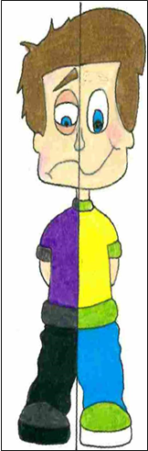
Safeguarding - Keeping Safe:
Information Designed by Young People for Young People.
A Project to develop Child Friendly Safeguarding Information:
Why
How
The Process
The Challenges
The Resources Required
The Influence
The Leaflets, Posters and Letter produced
The Prayer

Slide 5
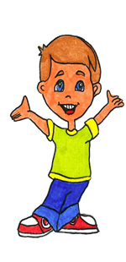
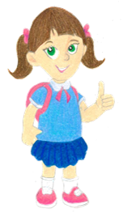
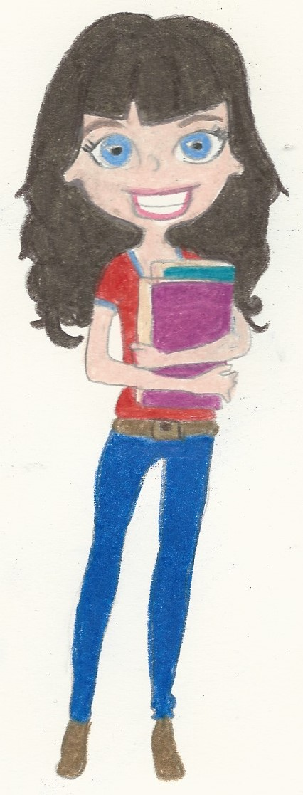
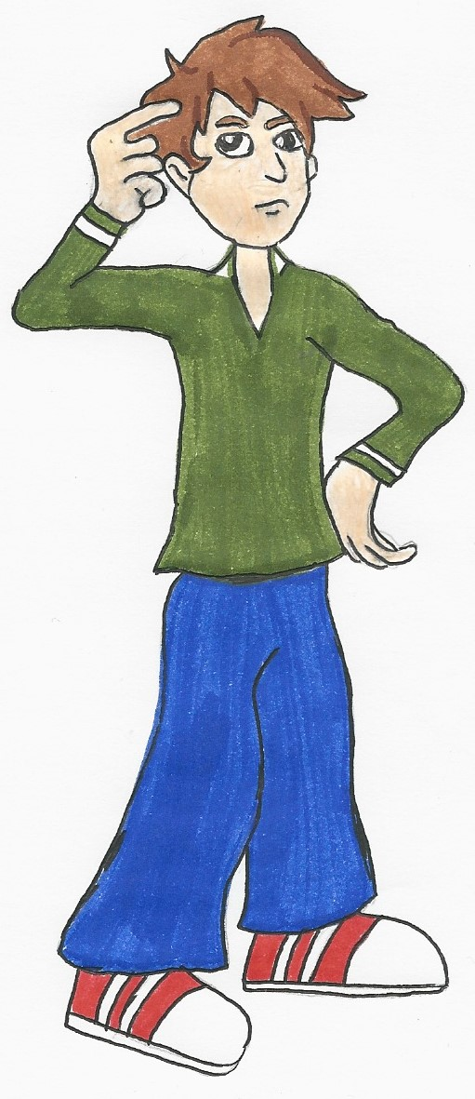

WHY?
As part of Standard 6 The Northern Province ,
Sisters of Mercy identified a gap in communicating
The Churches message about ‘Keeping Safe’
to young people.
We recognised that the message could be promoted more effectively by involving young people as they are best placed to communicate the message in a way that is relevant to them.
The Sisters asked if some students from Our Lady’s Grammar School, under the guidance of Sr. Oonagh and Sr. Yvonne, would take on the task of producing:-
Leaflet and Poster for Children – Primary School Age
Leaflet and Poster for Young People – Secondary School Age

Slide 6

Secondary School Leaflet
As facilitators we discussed what skills we would need the young people to have. These included:
IT,
Creative Thinkers,
Art Skills
Students who enjoyed working in a team.
We asked 5 of our 6th years who had some or all of these skills.
The girls said YES straight away and welcomed the idea to work in a group producing a leaflet that would help their peers.
And YPSPI (Young People Safeguarding Participation Initiative ) group came into being!
HOW

Slide 7

The Next Stage
Primary School Leaflet
When the secondary school leaflet/poster was completed we choose 4 first years, through an art competition where we looked for art and creative thinking skills, and the 6th year students agreed to work with them in producing a leaflet/poster for primary Schools.
Leaflet for Adults
When we were working on the Secondary School leaflet we had asked them to write a letter to parents on our theme of safeguarding. From this we got the idea to produce a parents leaflet.

Slide 8

THE PROCESS
Context: The Safeguarding Children Policy and Standards for the Catholic Church in Ireland 2016. Our work particularly focused on Standards 1, 5 and 6.
Specifically indicators:
5.5 The Church body provides children who access Church-related activities and their parents/guardians information, advice and support on keeping children safe, and involves them in church child safeguarding training initiatives wherever possible and appropriate.
6.2 Ensuring that information regarding the Church’s child safeguarding message is accessible.
We studied the UN Human Rights Convention for Children and picked the articles we felt relevant to our task. These formed a base for our discussions. (Reference: The UNICEF Children Rights Convention: Toolkit for Schools)
Safeguarding Young People
Designed and Compiled by Young People

Slide 9
THE PROCESS
How: Our process consisted of getting ideas – brain-storming, listening, sharing ideas, gathering information, looking at some leaflets that others had produced, sharing tasks, work between sessions, getting the School Councils advice, time management, surveys, finding words Primary School children could understand.
We used the headings from the existing Sisters of Mercy Leaflets adapted from the Diocese of Limerick as a framework for the Secondary Leaflet.
There was great energy in both groups and great co-operation and listening…everyone worked as a member of a team.
Safeguarding Young People
Designed and Compiled by Young People

Slide 10
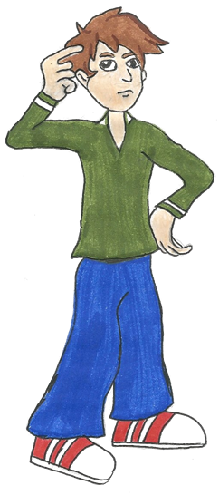
SOME CHALLENGES
Choosing colours was also a challenge with many ideas floating around.
TIME was a factor as we the 6th form students were doing exams, so for the first leaflet for Young People we met after school.
For the other leaflets we had to find time in school when we were all available as we, who were then 1st years, travelled by bus and we didn’t want to get later buses in town.
Getting the words right for the P.S. leaflet was challenging we didn’t want to use Physical, Emotional, Verbal and Sexual as in the Secondary School leaflet.

Slide 11
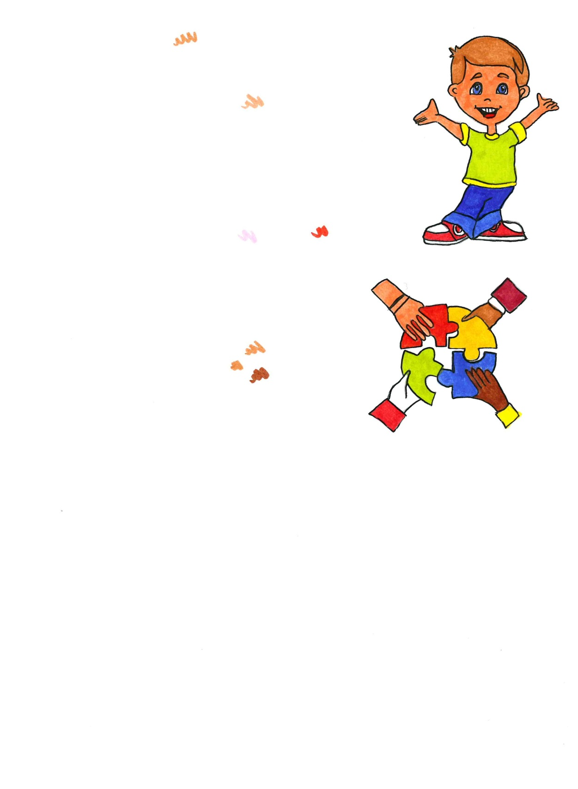

Art Materials
Access to Emails
Access to Computers
RESOURCES
Existing Leaflets
IT Person
Access to printers
Good Teacher/Pupil/School / Relationships

Slide 12
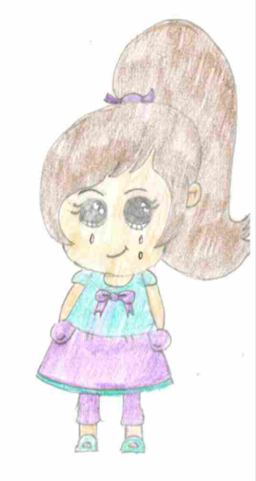

INFLUENCE
DON’T MAKE ME FADE INTO THE BACKGROUND
Our School are welcome to adopt the Leaflets.
The Leaflets and Posters were formally launched on 27th September, 2016. Guests included school pupils, staff, Sisters of Mercy Leadership Teams, Safeguarding Committees, and the National Board Director of Training and Support. Local Media were present and it was reported in the local newspapers.
Our work was commissioned by the Northern Province of the Sisters of Mercy . The Congregation of the Sisters of Mercy have adopted them, this includes the Western, Southern and South Central Provinces.
Our work has been cited as an example of good practice nationally and internationally.
The Northern Province of the Sisters of Mercy requested that we refrain from copywriting the leaflets and posters so that everyone who wishes can avail of them to ensure the message of safeguarding reaches far and wide.
The leaflets are available on the Sisters of Mercy Congregational and Provincial website.
And we were invited by the National Board to present our work today.
HELP ME TO BE HAPPY

Slide 13
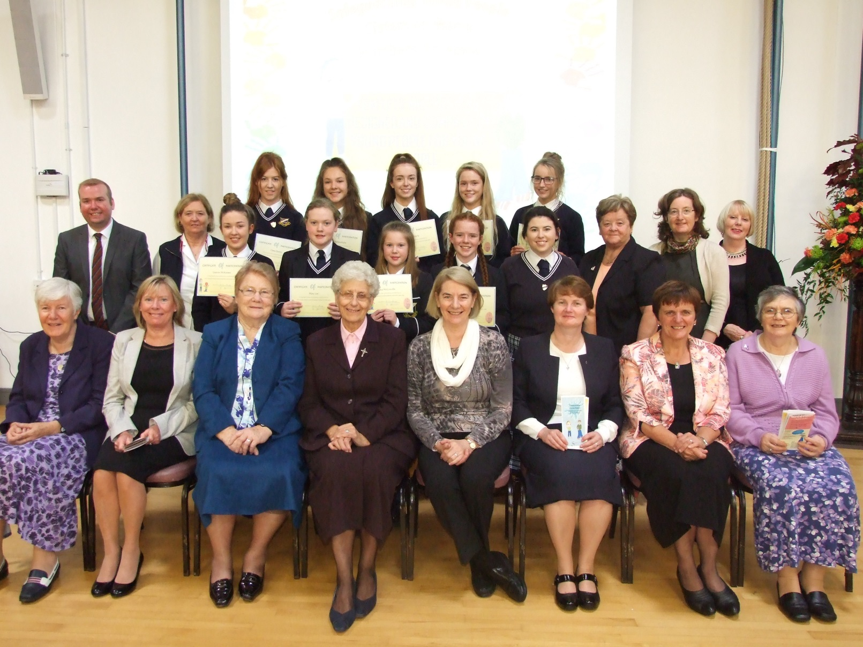
Launch of Safeguarding Leaflets and Posters
on 27th September.
Photo of launch

Slide 14
RESULT
Teenager’s Leaflet
Teenager’s Poster
Children's Leaflet
Children's Poster
Parent/Adult Leaflet

Slide 15
VIDEO presentation

Slide 16
Evaluation

Slide 17

A Prayer to keep us safe
Dear Lord,
We ask you to keep us safe and sound.
May people make us feel loved and supported.
Let no person do us harm.
Protect us from sadness.
Let us know what’s right and wrong
And give us strength to tell what’s going on.
Thank you God for always being there for us.
Amen

Slide 18
Safeguarding Young People
Sisters of Mercy
Northern Province
LEAFLETS AND POSTERS DESIGNED AND COMPILED BY YOUNG PEOPLE FOR YOUNG PEOPLE

